Slide 1


WELCOME STATE OF IDAHO
TO THE BUSINESS RENTAL PROGRAM

Slide 2

AGENDA
Introductions
Company Overview
Program Benefits/Program Costs
Billing options
How to book a Rental
Benefits of National
Q&A
Notes:
Agenda
The Power of the Brands
The Strength Behind You
Industry Recognition
Global Vision
Sustainability
Benefits of National and Enterprise
Total Cost
Implementation Guarantee
Proposal Details and Projected Costs
Q&A

Slide 3
Introductions
Kelly Jenkins
Heather Lawson
Account Manager
Director
Kelly.Jenkins@ehi.com
Heather.B.Lawson@ehi.com
208-658-0865 ext. 204
801-736-7314
Matt Roll
Scott Schlesinger
Group Rental Manager
Area Rental Manager
Matthew.Roll@ehi.com
Scott.B.Schlesinger@ehi.com
208-658-0865 ext. 203
404-210-4183
Notes:
Agenda
The Power of the Brands
The Strength Behind You
Industry Recognition
Global Vision
Sustainability
Benefits of National and Enterprise
Total Cost
Implementation Guarantee
Proposal Details and Projected Costs
Q&A

Slide 4





THE POWER OF THE BRANDS
2
Million
World Wide
10,000
World Wide
$24.1 Billion
VEHICLES
LOCATIONS
REVENUE
1,200,000
U.S. Fleet
506,2000*
365,000**
Enterprise
Holdings
Hertz
Dollar/Thrifty
Avis
Budget
Source: Auto Rental News – Fact Book 2019
*ARN estimate
Notes:
The Power of the Brands
Larger U.S. fleet than all major competitors combined (M vehicles)
More locations than any of our major competitors. 10,000 includes Alamo; 9,100 Enterprise and National only

Slide 5


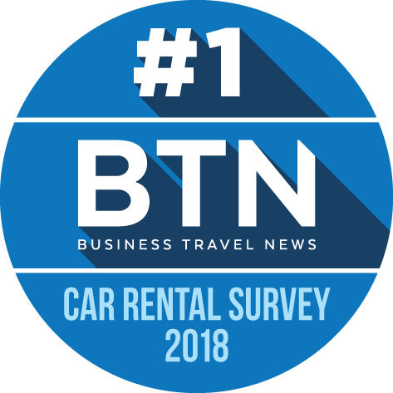


Preferred
Car Rental
Brand
Best Car Rental Company in North America
No.1
Car Rental Agency
Notes:
Business Travel News named National Car Rental and Enterprise Rent-A-Car the top preferred car rental brands for business travel in its fourth annual Car Rental Brand and Ground Transportation Survey of corporate travel buyers;
Business Traveler USA magazine selected National Car Rental as the Best Car Rental Company in North America in its 30th Annual 2018 Best in Business Travel Awards
National Car Rental, Enterprise Rent-A-Car and Alamo Rent A Car claimed three of the top five spots for car rental in the 2018 Travel + Leisure World’s Best Awards, which showcase the destinations, companies and brands that define the very best in travel as voted on by Travel + Leisure readers. National ranked No. 1 in the “Car-Rental Companies” category, followed by Enterprise at No. 2 and Alamo at No. 5, based on reader ratings across five characteristics: vehicle selection, vehicle availability, car rental location, service and value.

Slide 6


Notes:
BENEFITS OF NATIONAL AND ENTERPRISE [Dual logos/contemporary look]

Slide 7




Two Brands To Meet Any Need
One Loyalty Program Covering Both
Premium On-Airport and Business Center Solutions
Total Transportation Solution
Speed
Choice
Recognition
Travel Policy Compliance
Innovation
Emerald Aisle
Premier Selection
Priority Service
“We’ll Pick You Up”
High-Touch
Personal Service
Adaptable Solutions
Travel Policy Compliance
Mileage Reimbursement Solutions
Neighborhood Convenience
Recognized at major airports worldwide
Notes:
Now we want to define the brands globally, which will mirror how we have them positioned in North America. You need to make sure they understand why they are different and why that benefits the customer.
Utilize an analogy such as comparing our structure to the hotel industry. Through Hilton Honors or Marriott Rewards you get access to several different hotel brands, all of which offer a different type of service and service a different type of customer. Emerald Club is our loyalty program that will get you access to both brands and allow your travelers to earn and burn points and receive tier qualifications at either brand. To summarize, the brands will define the service, Emerald Club will be your access point to the brands.
Walk through the slide and explain the different services available at each brand without belaboring the point.

Slide 8


Notes:
The Benefits of Enterprise [Enterprise logo featured on motion bkgd]

Slide 9






Fee and Cost Reduction
SAVINGS
CONVENIENCE
OPTIONS
NASPO Agreement
Mileage reimbursement alternative
Elimination of Airport fees with Home-City network
Weekly and Monthly Discounted Rates
Over 7,700 locations in North America
25 locations in Idaho
90% of customers are within 15 miles of a location
Free pick-up from the office or home
Truck
Commute (Vanpool)
Car Sales
Fleet Management
Notes:
Savings [Graphic of $$$ or money sacks etc.]
Special corporate rates
Mileage reimbursement alternative
Long-term rental discounts
Convenience [Map of U.S. lit up with green dots – white copy over]
More than 7,700 locations in North America
90% of customers are within 15 miles of a location
Free pick-up from the office or home
Options [Vehicle pic montage]
Pickup trucks, cargo vans, etc.

Slide 10
Benefits of the State of Idaho Program
Competitive Set Rates for all car classes
Weekly and Monthly discounted rates
Unlimited Mileage
Full coverage
  CDW to cover rental up to a total loss
  SLP to cover third party liability up to $1M
Minimum Age of 18 (young driver fees waived)
Additional driver fees waived
No additional fees for same-state one way rentals!
Save on taxes and fees by renting at non-airport locations (9 non-airport locations in Treasure Valley)
Notes:
Time & Mileage: Base Rates, Special City Rates, City Differentials, Mileage Fees, One-Way Fees, Weekly Factor, Monthly Factor, One-Day Surcharge, Loss Damage Waiver, and Liability
Optional Services: GPS, Refuel, Toll Tag, Satellite Radio
Business Practices:
Capacity Control, Participating Locations, Energy Recovery Fees, Blackout Dates
Are Rebates On All Rentals?
One-Way Availability, and Best Rate
Taxes & Fees: Are They The Same?
Lower Cost, Lower Taxes
Bus Fees Can Vary

Slide 11






PROPOSAL BACKGROUND: TOTAL COST SOLUTION
100%
  No blackouts
  No Energy Recoupment fee
  No fees for late returns, no-show or rental extension
Agreement Compliance
Pay mid-size rate
Free choice upgrades
Skip the counter
Pick any car
  Home City Network
  Cut long-term rental costs
  Avoid airport taxes/fees
  Mileage reimbursement costs
Eliminate Frequent Flyer Fee
Lowest standard refuel fee
Notes:
Time & Mileage: Base Rates, Special City Rates, City Differentials, Mileage Fees, One-Way Fees, Weekly Factor, Monthly Factor, One-Day Surcharge, Loss Damage Waiver, and Liability
Optional Services: GPS, Refuel, Toll Tag, Satellite Radio
Business Practices:
Capacity Control, Participating Locations, Energy Recovery Fees, Blackout Dates
Are Rebates On All Rentals?
One-Way Availability, and Best Rate
Taxes & Fees: Are They The Same?
Lower Cost, Lower Taxes
Bus Fees Can Vary

Slide 12
Billing Options
Enterprise and National offers two types of Billing
Option 1 – Credit Card Account:
Credit Card account will allow you to have your Dept/Entity’s credit card hidden on file to pay for employees’ rentals.
Reservations are made by using your assigned account and billing numbers linked to your credit card.
The individual renting the vehicle will only need to provide a valid driver’s license at the time of rental.
Once the car has been returned, the hidden credit card will be charged, and a receipt will automatically be sent to your email address.
Notes:
Time & Mileage: Base Rates, Special City Rates, City Differentials, Mileage Fees, One-Way Fees, Weekly Factor, Monthly Factor, One-Day Surcharge, Loss Damage Waiver, and Liability
Optional Services: GPS, Refuel, Toll Tag, Satellite Radio
Business Practices:
Capacity Control, Participating Locations, Energy Recovery Fees, Blackout Dates
Are Rebates On All Rentals?
One-Way Availability, and Best Rate
Taxes & Fees: Are They The Same?
Lower Cost, Lower Taxes
Bus Fees Can Vary

Slide 13
Billing Options Cont.
Option 2 – Direct Bill Account:
Direct Bill account will allow your Dept/Entity to receive a monthly statement for all rental invoices.
Reservations are made by using your account and billing numbers.
The individual renting the vehicle will only need to provide a valid driver’s license at the time of rental.
A consolidated invoice will be generated monthly with all detailed charges of rentals with a total amount due.
Payment is expected within 30 days of invoice.
Notes:
Time & Mileage: Base Rates, Special City Rates, City Differentials, Mileage Fees, One-Way Fees, Weekly Factor, Monthly Factor, One-Day Surcharge, Loss Damage Waiver, and Liability
Optional Services: GPS, Refuel, Toll Tag, Satellite Radio
Business Practices:
Capacity Control, Participating Locations, Energy Recovery Fees, Blackout Dates
Are Rebates On All Rentals?
One-Way Availability, and Best Rate
Taxes & Fees: Are They The Same?
Lower Cost, Lower Taxes
Bus Fees Can Vary

Slide 14
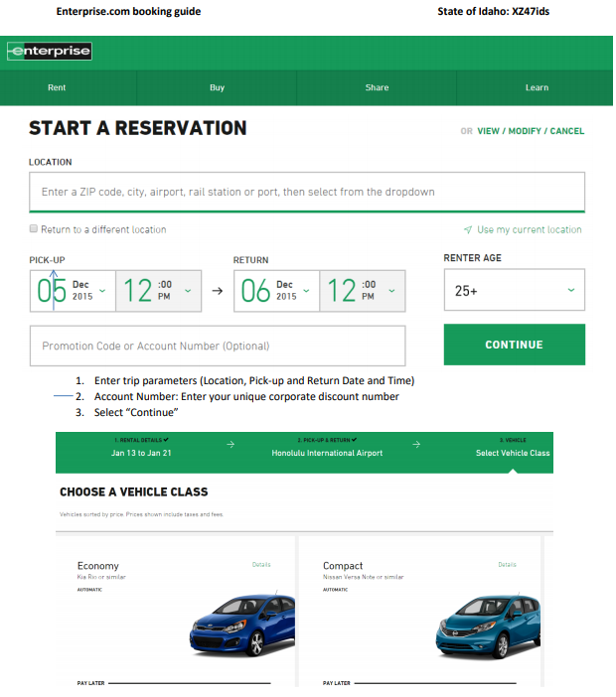
How to Book with Enterprise
Notes:
Time & Mileage: Base Rates, Special City Rates, City Differentials, Mileage Fees, One-Way Fees, Weekly Factor, Monthly Factor, One-Day Surcharge, Loss Damage Waiver, and Liability
Optional Services: GPS, Refuel, Toll Tag, Satellite Radio
Business Practices:
Capacity Control, Participating Locations, Energy Recovery Fees, Blackout Dates
Are Rebates On All Rentals?
One-Way Availability, and Best Rate
Taxes & Fees: Are They The Same?
Lower Cost, Lower Taxes
Bus Fees Can Vary

Slide 15
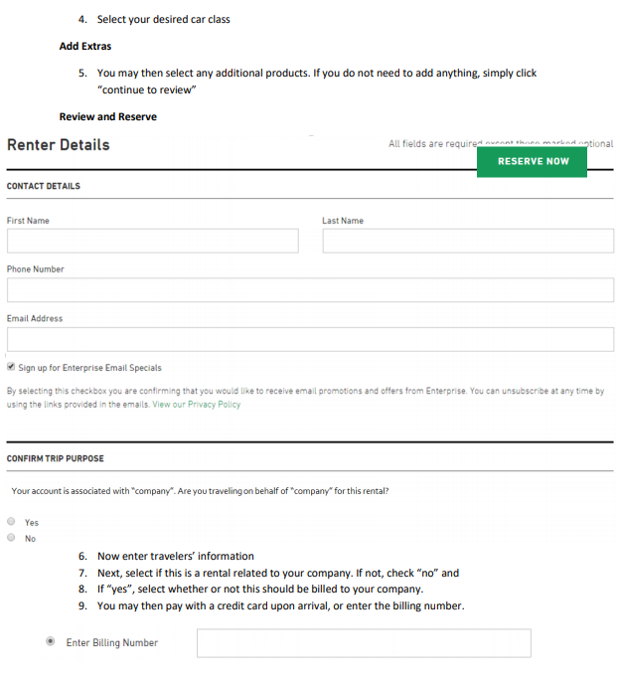
How to Book with Enterprise cont.
Notes:
Time & Mileage: Base Rates, Special City Rates, City Differentials, Mileage Fees, One-Way Fees, Weekly Factor, Monthly Factor, One-Day Surcharge, Loss Damage Waiver, and Liability
Optional Services: GPS, Refuel, Toll Tag, Satellite Radio
Business Practices:
Capacity Control, Participating Locations, Energy Recovery Fees, Blackout Dates
Are Rebates On All Rentals?
One-Way Availability, and Best Rate
Taxes & Fees: Are They The Same?
Lower Cost, Lower Taxes
Bus Fees Can Vary

Slide 16

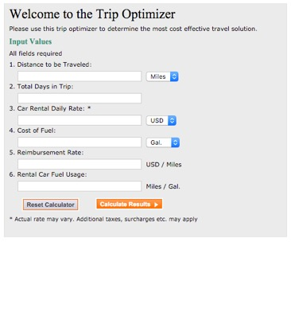

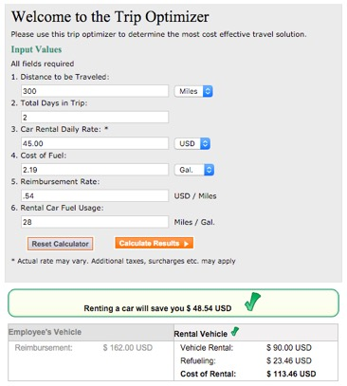
RENTING VS. MILEAGE REIMBURSEMENT
Let Enterprise conduct a free cost analysis for your department or agency!
Lower cost per mile & improved bottom line
Reduced liability expenses
Higher employee satisfaction
Efficiency with a safe new car
Consistent correct company image
Notes:
Renting vs. Mileage Reimbursement [Customer shots, roading shots]
Lower cost per mile & improved bottom line
Reduced liability expenses
Higher employee satisfaction
Efficiency with a safe new car
Consistent correct company image
[Replace bullets above with copy below]
Let Enterprise conduct a free cost analysis for your company!

Slide 17

Notes:
The National Difference [National logo prominent on motion blur bkgd]
You’re on the road to conduct business, you need to be productive.
We offer you the speed, choice and control to make that happen.

Slide 18
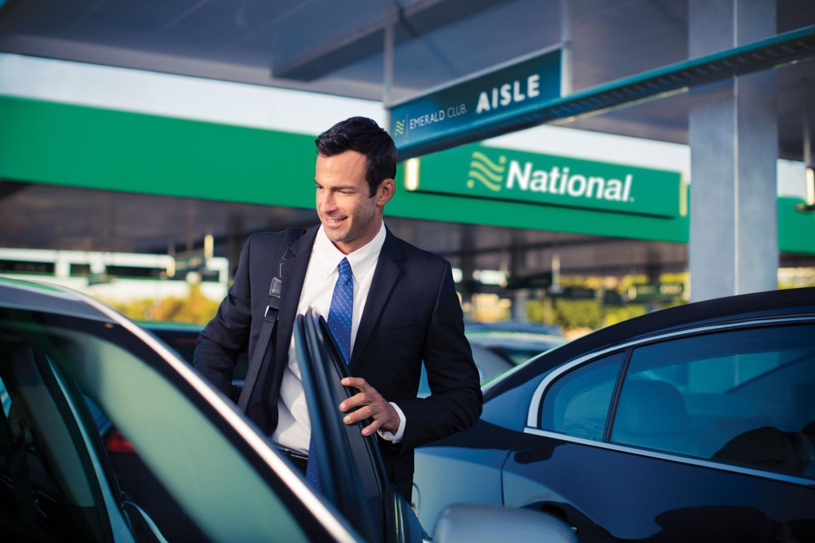
DEDICATED TO BUSINESS TRAVELERS
Fast, frictionless rental process
Choose their own car
Customize their rental preferences and rewards
Earn Emerald Club rental credits at participating Enterprise Rent-A-Car locations*
Assurance National is where they want, when they want
* Available at select locations only. Expedited counter service available at all other locations.
Notes:
Dedicated to Business Travelers: [Business traveler shot]
Fast, frictionless rental process
Choose their own car
Customize their rental preferences and rewards
Assurance National is where they want, when they want*
Drop down box or slide footer:]
*(Rental locations are available at every major airport in North America.)
Recognized at more than 6,000 North American locations

Slide 19

1
Reserve and pay
for a midsize
2
Bypass the
counter
3
Choose any car
Notes:
Emerald Aisle: 3 Easy Steps [Three panels to depict three easy steps]
Reserve and pay for a midsize
Bypass the counter
Choose any car*
(*To comply with your company’s midsize car policy we only charge midsize rates even if you choose a larger vehicle from the Emerald Aisle)

Slide 20



EMERALD CLUB MEMBERSHIP
Free for every traveler
0-11 rentals or 0-39 days
Bypass the counter, choose your own car
Automatic upgrades, no blackout dates
Drop & Go℠ car return
Earned membership
12-24 rentals or
40-84 days
Executive selection
Guaranteed upgrade
Earned or invited membership
25+ rentals or
85+ days
Guaranteed upgrade
Guaranteed car with 24-hour notice
FBO DELIVERY FOR ALL LEVELS
Notes:
Emerald Club Membership – 3 TIERS (Three panels bring up each tier)
[Emerald Club panel animates up]
Complimentary for every traveler
Bypass the counter, choose your own car
Automatic upgrades, no blackout dates
Drop & Go℠ for express car return
[Executive panel animates up]
Earned membership
Executive selection
Guaranteed upgrade
[Executive Elite panel animates up]
Guaranteed upgrade
Guaranteed car with 24-hour notice
FBO delivery
Emerald Club members can earn rental credits at participating Enterprise Rent-A-Car® locations* Enterprise service will be provided

Slide 21

Q&A
Notes:
Q&A [Contemporary roading/vehicle shot]

