Slide 1

Pcard Training

Slide 2

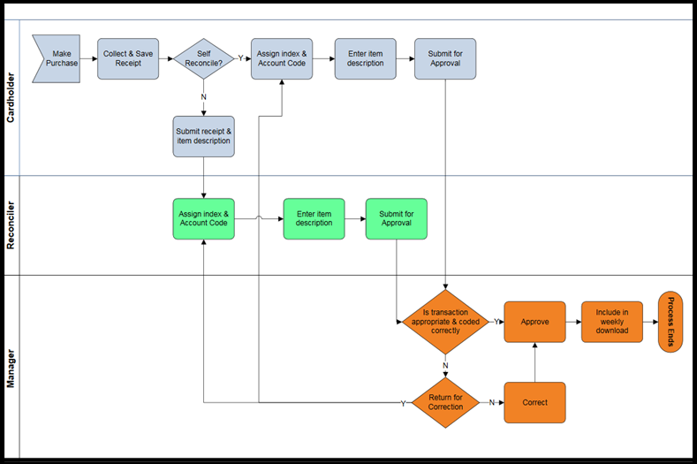

Pcard Reconciliation and Approval Process Flow

Slide 3
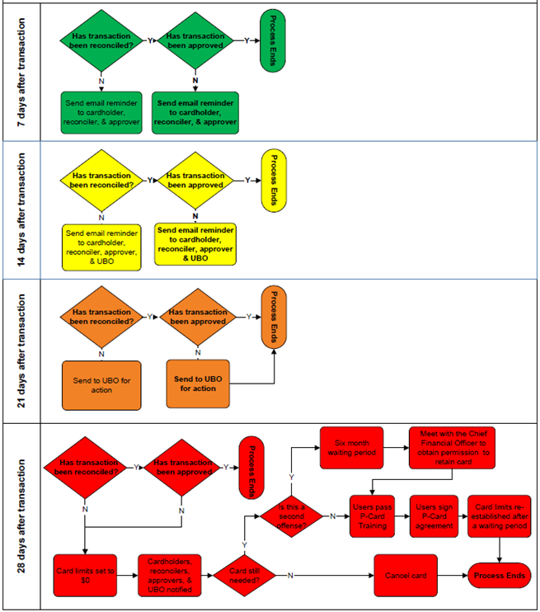
Pcard Notification Process
Reminder email notifications will go out weekly.
Reconcile your transactions as soon as possible.
Online purchases should be reconciled and approved as soon as the transaction is posted and the goods have been received.
In person purchases can be reconciled and approved as soon as the transaction posts.
All transactions need to be reconciled and approved within the 28-day time limit or your Pcard privileges may be revoked.

Slide 4
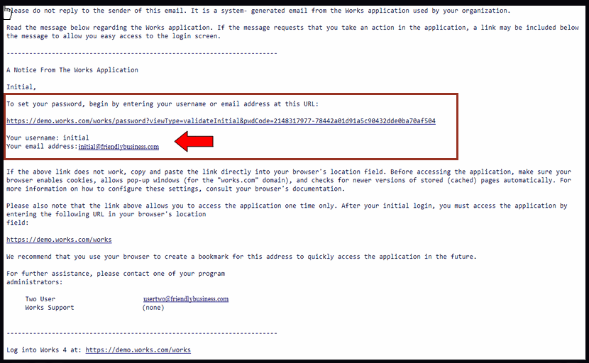
Logging into Bank of America for the first time
You will receive a Welcome email from Bank of America when your new Pcard is ordered.
Click on the link highlighted within the red box. This link can only be used once. If not used within 60 days the link will expire.
The red arrow points to your username and email address you will use to login.

Slide 5
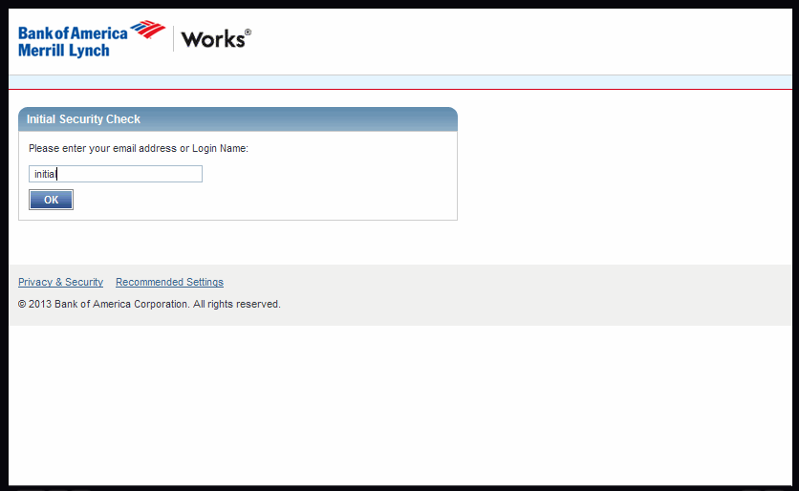
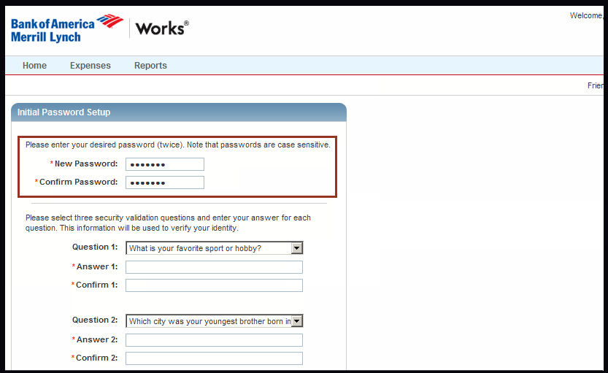
Follow instructions to create your password and answer 3 security questions.

Slide 6
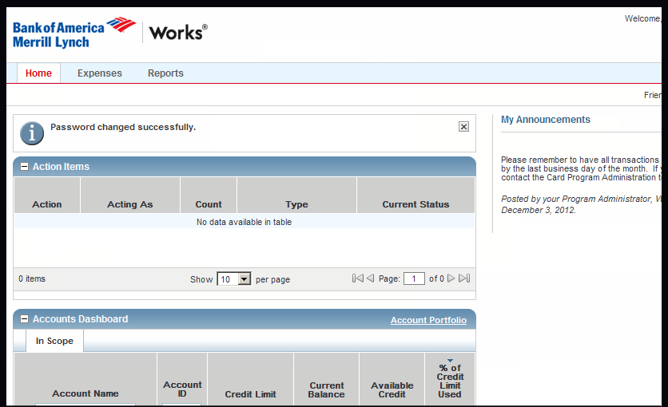
Now you are set up and ready to use Works.

Slide 7
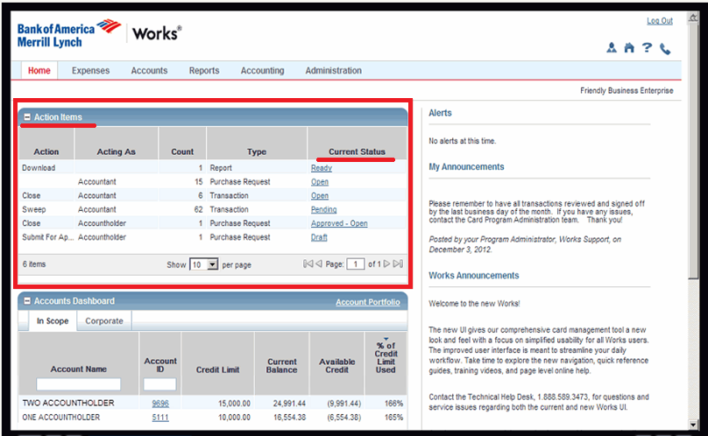
Action Items needing your attention.
On the Home page you will find Action Items. This is a list of items that require your attention.
Click on the blue link in Current Status to see what is pending (needing to be reconciled or approved).

Slide 8
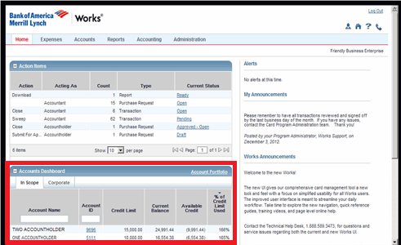
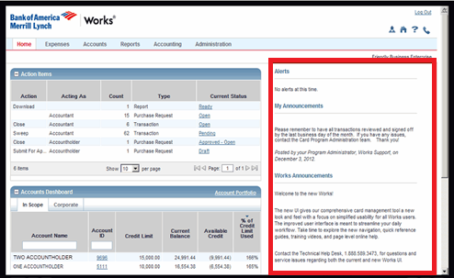
Additional information on the Home page
The Accounts Dashboard is a quick view of the basics of the account(s) that you are responsible for.
The Alerts section is a message board relaying messages from the Pcard Administrators or directly from BofA.

Slide 9
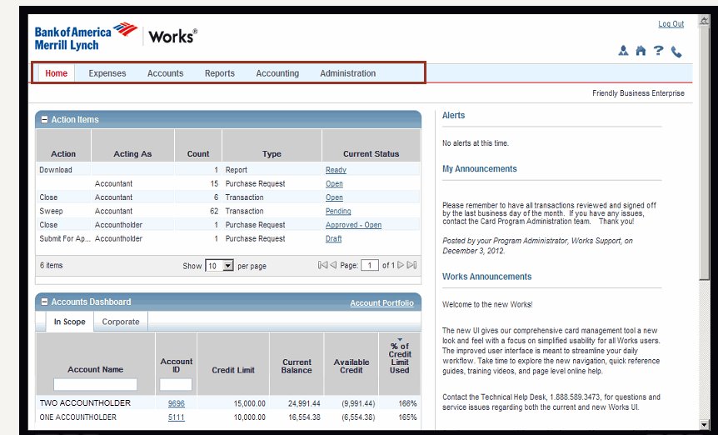
Navigation Bar
You will do a lot of navigating in Works from this navigation drop down bar. Not everyone will have all of these tab options. It depends on the scope of your responsibilities in the Pcard program.
We recommend investigating all the tabs and see what they do.

Slide 10
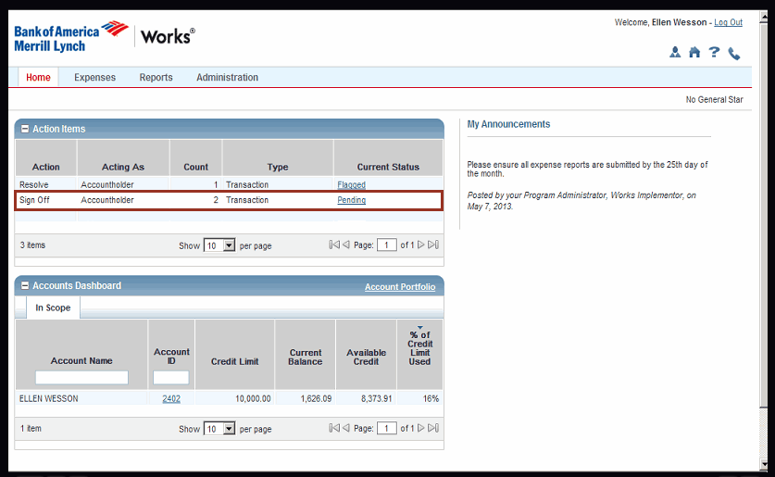
RECONCILING TRANSACTIONS
To reconcile a transaction, click on the Pending link. This will take you to a list of all transactions requiring signoff.

Slide 11
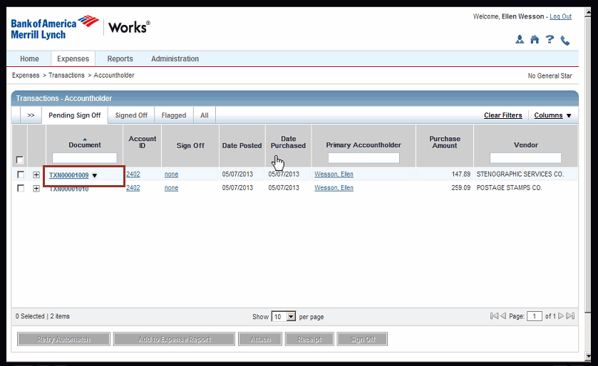
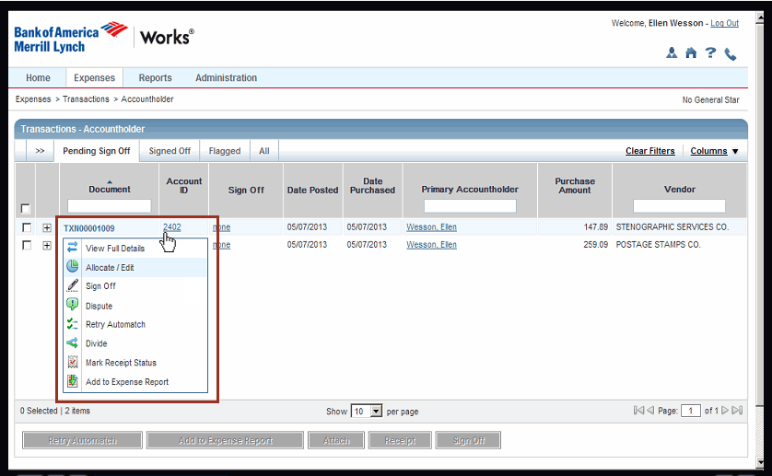
Allocate / Edit
Click on the transaction TXN number for a drop down list.
In the drop down box list, click on the Allocate/Edit option.

Slide 12
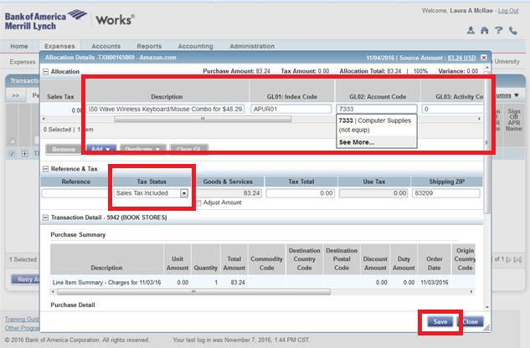
Allocation Details
Delete out the default description then add a description of the item purchased.
  Be specific! What is it? What event, department, or person is it for?
  If it’s a refund, put the original transaction number in the description. Example: Refund for TXN0001009
Add the GL01:Index Code
Add the GL02:Account Code
Make sure that there is a 0 in GL03: Activity code
Change Tax status to Non-Taxable Purchase
Click SAVE, then click CLOSE

Slide 13
How to Find Your ISU Index Code
Each department should only use their own index code when reconciling a Pcard purchase. If you do not know your index code please contact your supervisor. Before placing an order obtain the index code and determine that there are available funds for the purchase.
If purchasing an item that will be paid for from funds outside your area, it is important that you have written permission to charge another department’s index code in advance of buying the item. Keep that written permission (email/memo) with your receipt records.

Slide 14
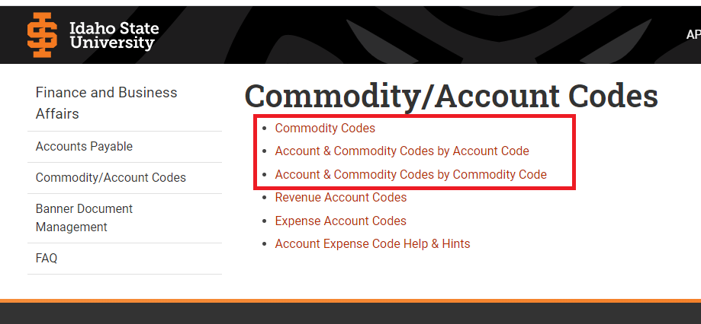
Account Codes
https://www.isu.edu/financeadmin/accounts-payable/commodityaccount-codes/
To find the list of account codes you can use the above link. We also have a link to the account codes document on our purchasing website. Isu.edu/purchasing
The list is long, so if you click CTRL+F a search box will open. Type in a key word and press enter.

Slide 15
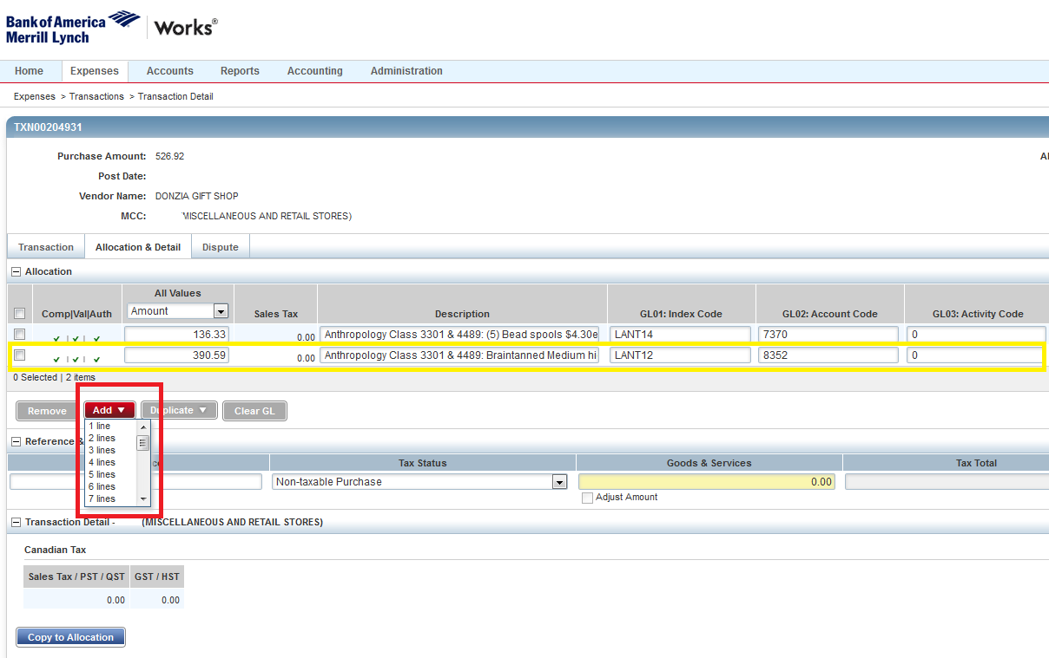
Adding lines for reconciliation
If you have more than one item on your receipt that needs to be allocated to a different index or account code, you will need to separate them out into different line items when you reconcile. This includes creating a separate line item for shipping costs.
To add more lines click the ADD box. Choose the number of lines you will need. Then add the description, account code, and index code for the other item(s). Also make sure on subsequent lines that the GL03: Activity code has a 0 in the box.

Slide 16
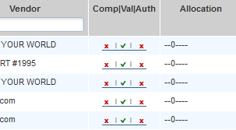
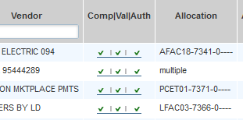
Verifying that the allocation was done correctly
Before you allocate the transaction, the Comp/Val/Auth will look like this.
After you have allocated correctly you should have 3 green check marks. If you don’t, then something was done incorrectly.

Slide 17
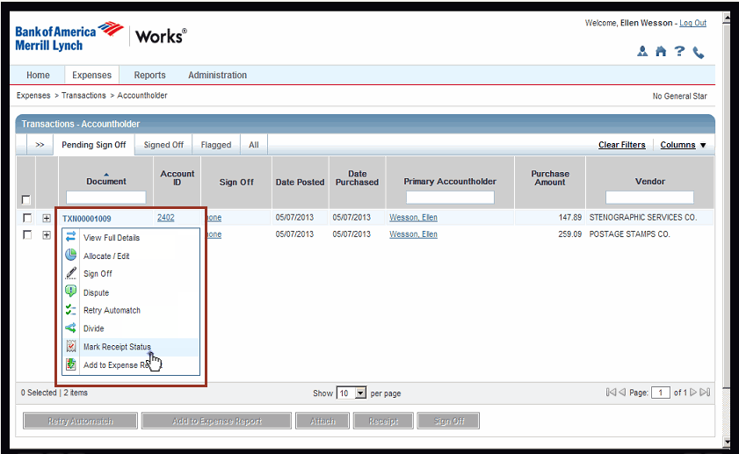
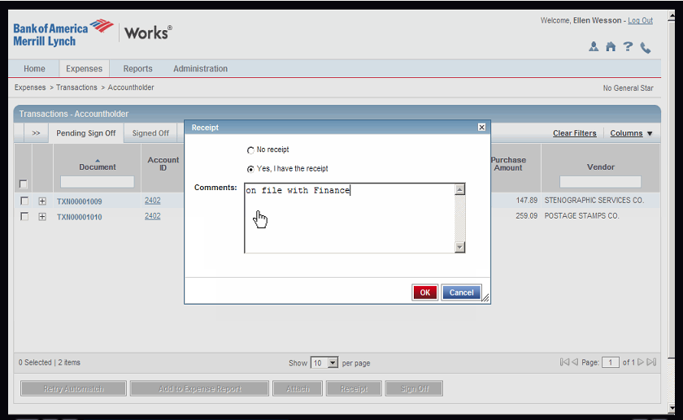
Mark Receipt Status
To mark the receipt status click on the drop down box of the transaction again and chose Mark Receipt Status option.
In the box that pops up, indicate whether you have a receipt or not. If not, you will need to enter a comment stating the documentation you do have. Example: Lost receipt, filled out a No Receipt Available form. Click OK

Slide 18
Uploading Receipt Image
You are REQUIRED to upload your receipt into Bank of America. This is for approval review and auditing purposes.
Uploaded receipts are NOT a replacement for keeping receipt records in your department. Bank of America will delete all receipt images after 2 years, so you will still need to keep your receipt records and all applicable documentation (meals forms, gift card exemption form, EPLS proof, and any other additional documentation) in your department. Auditors will be checking your records kept in your department as well as the uploaded images.

Slide 19
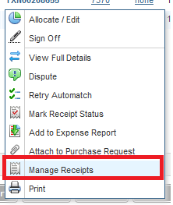
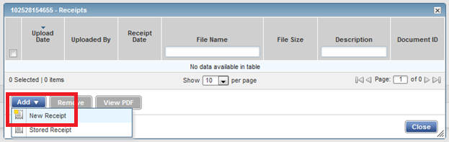
How to upload a receipt
Select Manage Receipt
Select Add then New Receipt

Slide 20
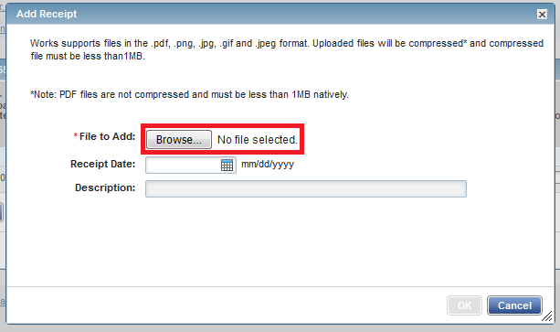
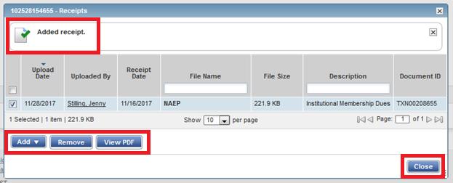
How to upload a receipt
Select Browse
Find and select your scanned receipt. You also have the option of selecting the receipt date and add a description, but this step is not required.
Select OK
Your receipt has now been added.
You have the option to add more documents, remove the document already added, or view the document.
When done select Close

Slide 21
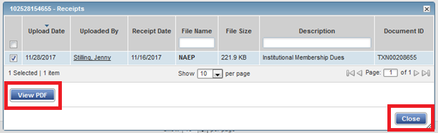
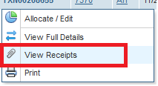
How approvers can view the receipt image.
Click on the transaction number
Select View Receipts
Select View PDF to view the receipt image.
When done Select Close

Slide 22
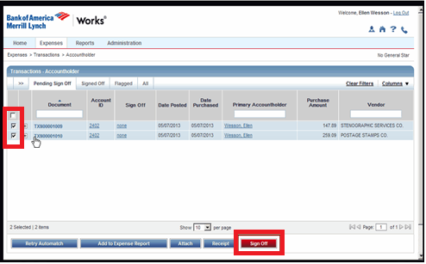
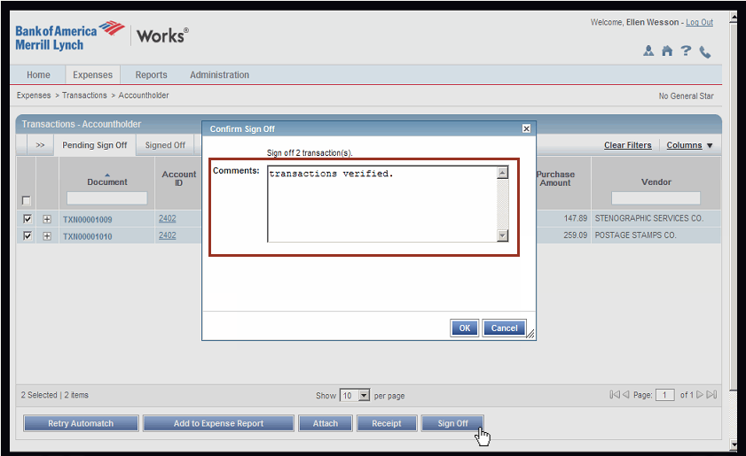
Sign Off and Comments
Click the box next to the transaction you want to sign off, Then click Sign Off
After you have clicked Sign Off, a comments box will pop up. Make any relevant comments in this box. Example: “I didn’t buy from the state contracted vendor because the item was available at a local vendor for less.” Click OK and then you’re done!

Slide 23

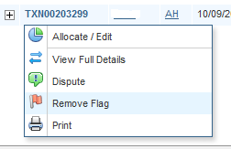
Flagged Transactions
If your approver sees something wrong with the way you’ve allocated your transaction, they can FLAG the transaction and send it back to your queue for correction. The approver will leave a comment letting you know what you need to fix. Fix the problem and remove the flag to send it on to be approved again.

Slide 24
APPROVING A TRANSACTION
The process of approving transactions is very similar to the way they are reconciled.
  Click the pending link. Then click on the TXN number and view full details.
  Check the description.
  Check the index and account codes.
  Check and see if they changed the tax status to Non-Taxable Purchase.
  Check the receipt.
  If it’s not correct you flag the transaction and send it back to the reconciler to fix.
  Click on the box next to the transaction, then click Sign Off.

Slide 25
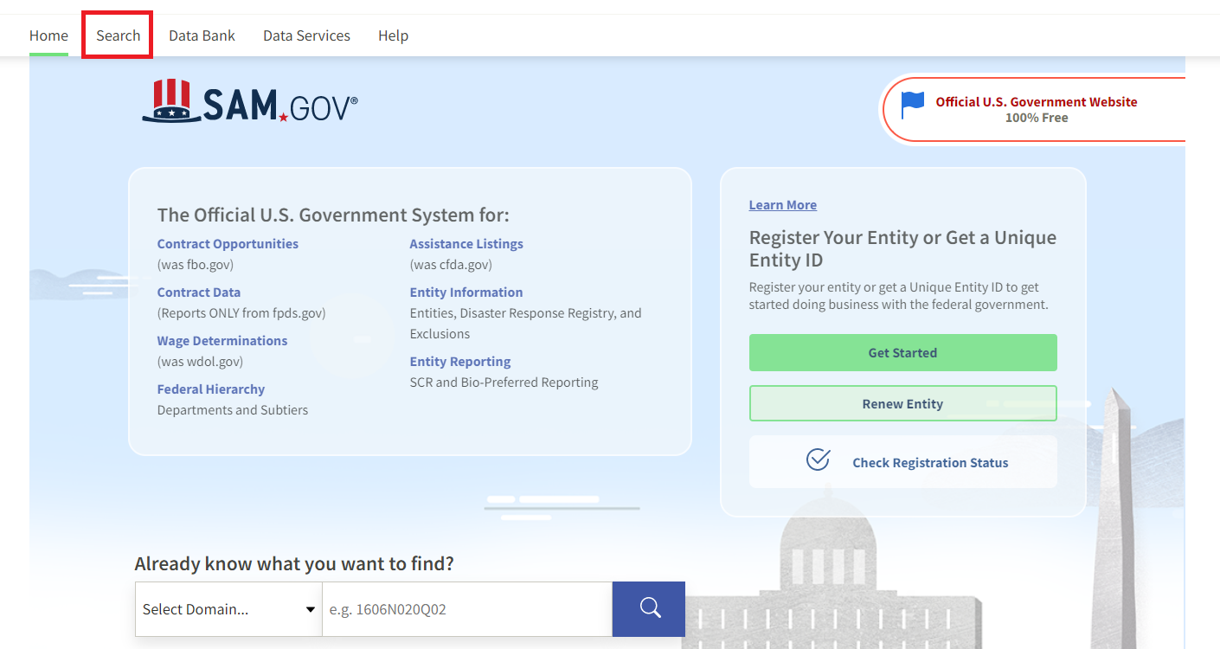
Federal Funds/ Grant Funds Requirement
If you are using federal/grant funds you are required to do a vendor screening called an EPLS check before you buy from that vendor. This will make sure the vendor you plan on purchasing from has not been debarred or suspended from doing business with government funds. https://sam.gov/content/home
You can find the EPLS tutorial instructions on how to do this on the Purchasing website. isu.edu/purchasing
Proof this was done is required to be kept with receipt records.

Slide 26

Buying From Vendors outside the USA
If you are purchasing from a vendor outside the USA you will need to do the sam.gov EPLS vendor screening (see previous slide) no matter what type of funds are spent. This ensures the vendor is not disbarred/suspended, or operating in countries where we cannot legally make purchases from.
When you make an international purchase you will be charged a bank fee called an International Transaction Fee. Please allocate this to the same index and account code as the transaction that prompted the bank fee.

Slide 27


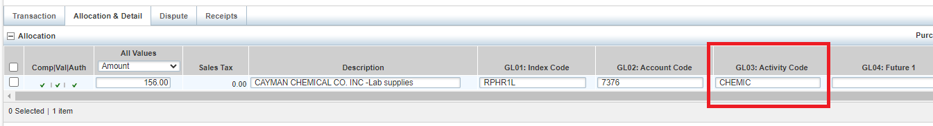
Hazardous Chemical Purchases
Environmental health, safety, and Sustainability are required to track all hazardous chemicals purchased for the University. When you purchase hazardous chemicals you will be required to add an activity code in the GL03 box when reconciling. If you are unsure if the chemical is hazardous you can contact the EHSS office for clarification.
  Hazardous chemical activity code: CHEMIC

Slide 28

Drone Purchase
We are tracking drone purchases because of new regulations requiring drones to have remote ID’s
Drone Purchases should be done through our requisition application, Jaggaer. However, some circumstances require the drone to be purchased on a Pcard. If purchasing a drone on a Pcard you must add an activity code in the GL03 box when reconciling.
Drone activity code: DRONE

Slide 29

Furniture Purchase
All furniture purchases need to comply with the University brand and be approved by the University Designer in Facilities Services before the purchase is made on a Pcard.
To help guide you on what the branding look is, you can go to isu.edu/brand and click on the Facilities Lookbook.

Slide 30
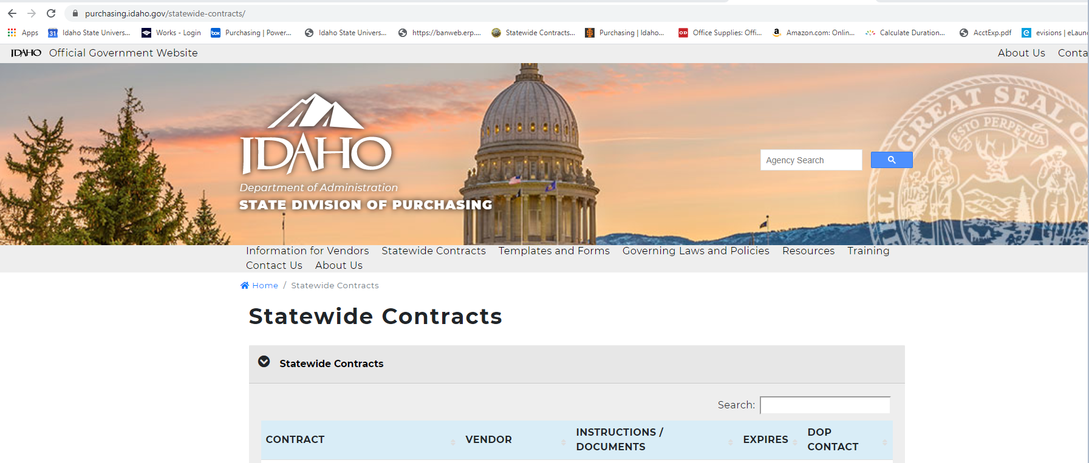
State Contracts
State contracts should be the first choice for university purchases. The State of Idaho maintains an extensive group of contracts for use by ISU. If contract vendors cannot provide a necessary item, it may be purchased off-contract.
Here is the link to the statewide contracts https://purchasing.idaho.gov/statewide-contracts/

Slide 31
Exceptions to using State Contracts
Exception 1: If the state contracted vendors can’t provide what you need, you can buy off-contract. We encourage you to use local vendors when possible.
  Documentation is needed. When reconciling, in the comments section at signoff, note the reason you weren’t able to purchase through state-contract. (Ex: ‘Out of stock until _____’ or ‘didn’t carry the specific item needed’.)
Exception 2: If you find the same item for a lower price at a non-contract vendor, then you are allowed to purchase that item from that vendor rather than the state contract vendor.
  Documentation is needed. Provide both state and non-contract vendor prices to document the item purchased was for less. This can just be written on the receipt records or you can print up price quotes. Either way, it has to be documented.
Exception 3: Emergency purchases. See purchasing policy ISU policy 2560 for information on emergency purchases.
  Documentation is needed. When reconciling, In the comments section at signoff, make note of the emergency and why you needed the item immediately. Also make note of the emergency on the physical receipt records.

Slide 32

FRAUD
Frequently, Bank of America will catch fraudulent transactions before you do. When BofA suspects fraud is occurring on your Pcard, they will put a hold on your Pcard and notify the purchasing office of the possible fraud.
The purchasing office will then contact you, as the cardholder and ask you to validate your purchases.
If the purchases are valid we will have the hold on your Pcard removed.
It they are fraud charges we will have your card shut down, and BofA will issue you a new card.
If you find fraudulent transactions occurring on your Pcard, CALL THE PURCHASING OFFICE RIGHT AWAY. The purchasing office will call Bank of America and have your card shut down, and BofA will issue you a new Pcard.
If it is after working hours, call Bank of America directly and inform them of the fraud. Also inform the purchasing office that you contacted Bank of America so we are aware of the situation.

Slide 33

FRAUD
Department cards carry more risk because of multiple users. If fraud occurs on a department card it is at the discretion of Bank of America as to whether or not they will refund the fraud charge. If they do not approve the fraud transaction the department will be responsible for paying the fraud charge amount and no refund will be made.
If the fraud is on your individual Pcard, Bank of America will refund the fraudulent purchase.
Reconcile the fraud charge and the refund for the fraud charge to your local index code and use account code 7898.

Slide 34
Shipping Address
The address associated with your Pcard is ISU’s central receiving’s address, 638 E Dunn, Pocatello, ID 83209. If you don’t use it when purchasing online, your transaction will be declined by Bank of America.
Make sure you put your name/department and stop # if you are having your package shipped to ISU’s central receiving address.
[Your name/dept. and stop #]
Idaho State University
638 East Dunn
Pocatello, ID 83209
Most online vendors give you the option of having a second address for shipping. If you want your purchase to go to your office instead of through central receiving, use the second shipping address option.

Slide 35
Authorized Purchases
This is not an all inclusive list.
Chartwells and ISU Bookstore
Advertising Expense (such as: newspapers, magazines, web, and other media)
Automotive Parts
Books
Building Supplies
Classroom Audio and Visual Aids
Classroom Teaching Models
Computer Repair Parts
Computer Supplies, (ie. CD’s, DVD’s, Flash Keys, Toner, monitors, keyboards)
Electrical Material
Field Supplies
Hardware
Lab Supplies
Non-Employee and Student Recruitment Expenses
Office/Class Supplies (use state contracts)
Petty Cash Items
Photography Supplies
Plumbing
Repair/Spare Parts
Safety Supplies
Short-Term Equipment Rentals
Software Renewals (not new software)
Subscriptions
Tools
Training/Conference Registration Held at an Employee Workstation
Travel of Non-Employees (not receiving payment for fees)
Work-Related Licenses
Work-Related Membership
Work-Related Organizational Fees

Slide 36
Unauthorized Purchases
This is not an all-inclusive list.
Alcoholic Beverages
Ammunition
Capital Expenditures $2,000 or more
Cash Advances
Cellular Phones, Monthly Contract Fees
Computers/ Laptops/ Tablets
Controlled Substances
Donations
Entertainment
Firearms
Fuel for Personal or Rented Vehicles
Gift Cards (unless approved)
Live Animals
Payment to ISU Departments
Personal Expenses
Photocopiers and Printers over $300
Prepaid Phone Card
Radioactive Materials
Stamps (use ISU mail center)
Salaries
Scholarships
New Software
Stipends
Travel -Employee Related (Refer to the Travel Card)
Tuition and Fees
Wages

Slide 37
Paying for Conferences or Training
Any registration for conferences or training that is outside of your normal work area (i.e., would require travel authorization), CANNOT be put on the Pcard.
Registrations for local conferences or local/online training(i.e. Main Campus -would include Pocatello), and requires no reimbursement for travel, CAN be put on the Pcard.

Slide 38


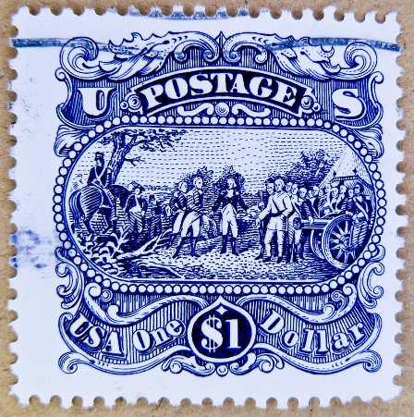
Stamps and Postage
Stamps and postage are considered currency and cannot be purchased on a Pcard, unless you are outside of the ISU Mail Center area (Idaho Falls, Meridian, Twin Falls) OR have authorization from Purchasing.

Slide 39
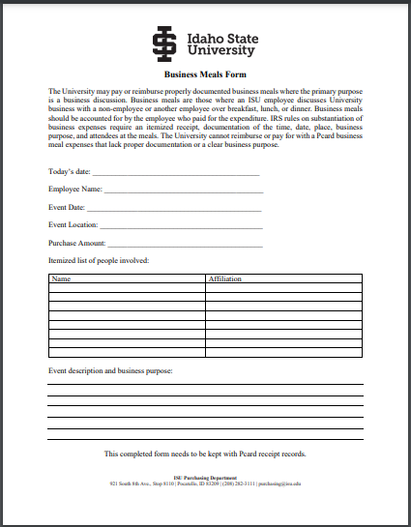
Meals and Refreshments for Meetings
Meals and Refreshments for meetings can be purchased on the Pcard only if the requirements in ISU Policy # 2530 Non-Travel Meals, Refreshments, are met.
This policy can be found at isu.edu/policy Click on Finance. Then click on policy 2530
Part of this policy requires that you fill out a Business Meal Form. You can find this form on our purchasing website. You will need to keep this completed form with your Pcard receipt records.

Slide 40
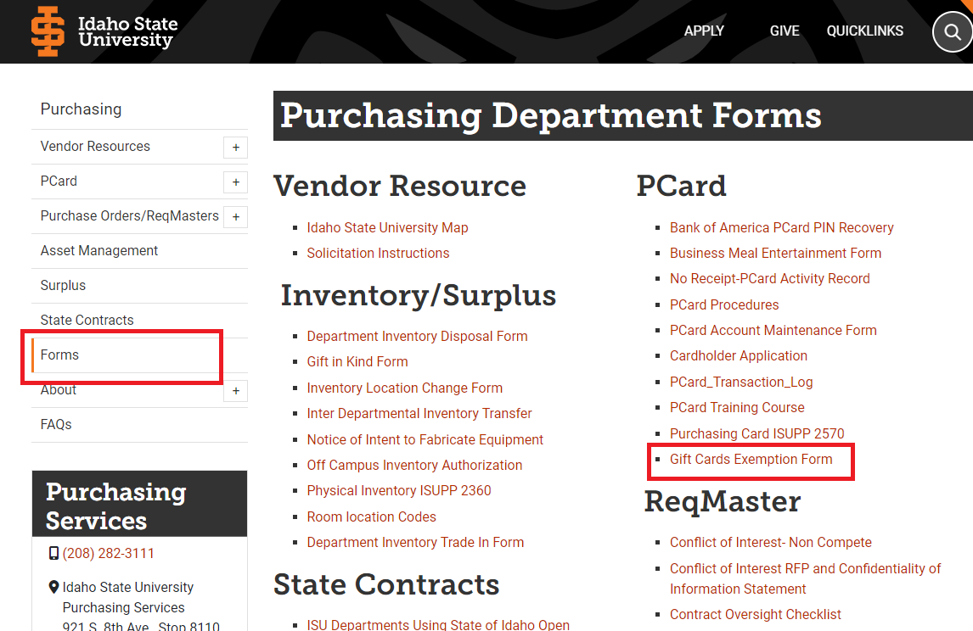
Gift Cards
Purchasing gift cards on your Pcard is prohibited unless you fill out the Gift Card Exemption DocuSign form. You find that form on the purchasing website under forms. isu.edu/purchasing
You must wait until the exemption form gets approved before you can purchase the gift card(s).
You must keep the completed DocuSign form with your receipt record.
You must fill out the Prize, Award, and Research Incentives DocuSign form and a W-9 tax form with the information of the recipient of the gift card. Both these forms are found on the Division of Finance website under forms. Isu.edu/financeadmin

Slide 41

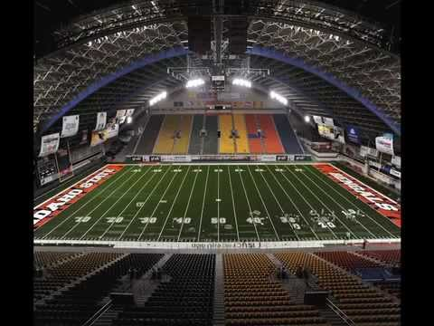
Do NOT use your Pcard on campus
The only places you can use your Pcard on campus is with Chartwells and the ISU Bookstore.
You are NOT allowed to use your Pcard to pay other ISU departments. We are charged a transaction fee if you do. Do not use your Pcard at the following:
  Holt Arena
  The History Museum
  Bengal Pharmacy
  Any ISU department
  On Campus transactions should be done with a direct transfer of funds from index to index through the Accounting office.

Slide 42
Travel NOT allowed on Pcard
Travel and related travel expenses are NOT allowed to be paid with using the Pcard.
Anything that would need to go on a Travel Authorization, cannot be put on the Pcard. If you have questions please contact Purchasing or the Accounting office for clarification.
A Pcard can be used for travel expenses for non-ISU employees. This includes candidates recruited for employment, expenses for student recruits being brought to campus, guest lecturers, or performers. (excluding fuel)

Slide 43

Software
NEW software should be purchase on a requisition NOT with your Pcard. New software usually has terms and conditions that need to be reviewed before it can be purchased.
Software RENEWALS are allowed to be purchased on a Pcard.

Slide 44

IT Equipment, Printers, and Copiers
Information Technology equipment, printers, and copiers that are $300 or more CANNOT be purchased with a Pcard. These items must be purchased on a purchase order (PO) so they can be tagged and inventoried. Items that fall in this category are.
  Computers/Laptops
  Tablets
  Fax machines
  Copiers and printers

Slide 45
Consequences of Misuse
THE USE OF A PCARD IS A PRIVILEGE, NOT A RIGHT. Corrective action will be taken for misuse of the card.
FIRST VIOLATION: Use of the Purchasing Card will be suspended. Notification will be given to the cardholder or card manager and their immediate supervisor. The cardholder must have a meeting with the Purchasing Card Administrator to provide additional training, and identify specific corrective actions required.
SECOND VIOLATION: Use of the Pcard may be suspended for up to six (6) months. Notification will be given to the cardholder or department card manager and their immediate supervisor. Reinstatement may be considered upon receipt of a letter from the cardholder’s or department card manager’s supervisor to the Pcard administrator, providing a compelling argument as to why the card should be re-instated.
THIRD VIOLATION: Cardholder’s/department card manager’s card will be cancelled and the cardholder/department card manager will be prohibited from any further use during their employment at ISU. Notification will be given to the cardholder/department card manager and their immediate supervisor.

Slide 46
Examples of Misuse
Making unauthorized purchases.
Not getting transactions both reconciled and approved before the 28 day limit.
Not keeping with your receipt records or providing to auditors additional documentation when applicable. (Meals form, Gift Card Exemption form, Price difference documentation when not using state vendors when you should)
Chaining: splitting a single item purchase amount into two transactions to try to bypass the single purchase limit. (Ask for a temporary raise in your single purchase limit from Purchasing, or create a requisition.)

Slide 47
Please Review
Purchase Card Guidelines
Purchasing Card (PCARD) Policy ISUPP 2570
Non-Travel Meals, Refreshments ISUPP 2530
Gifts, Awards, Prizes, and Incentives ISUPP 2010
Purchasing Policy ISUPP 2560
  These policies can be found at isu.edu/policy in the Finance section. https://isu.edu/policy/finance/

