Slide 1
IDAHO DENTAL EDUCATION PROGRAM
2026
“EDUCATING DENTISTS FOR
TODAY AND TOMORROW”

Slide 2
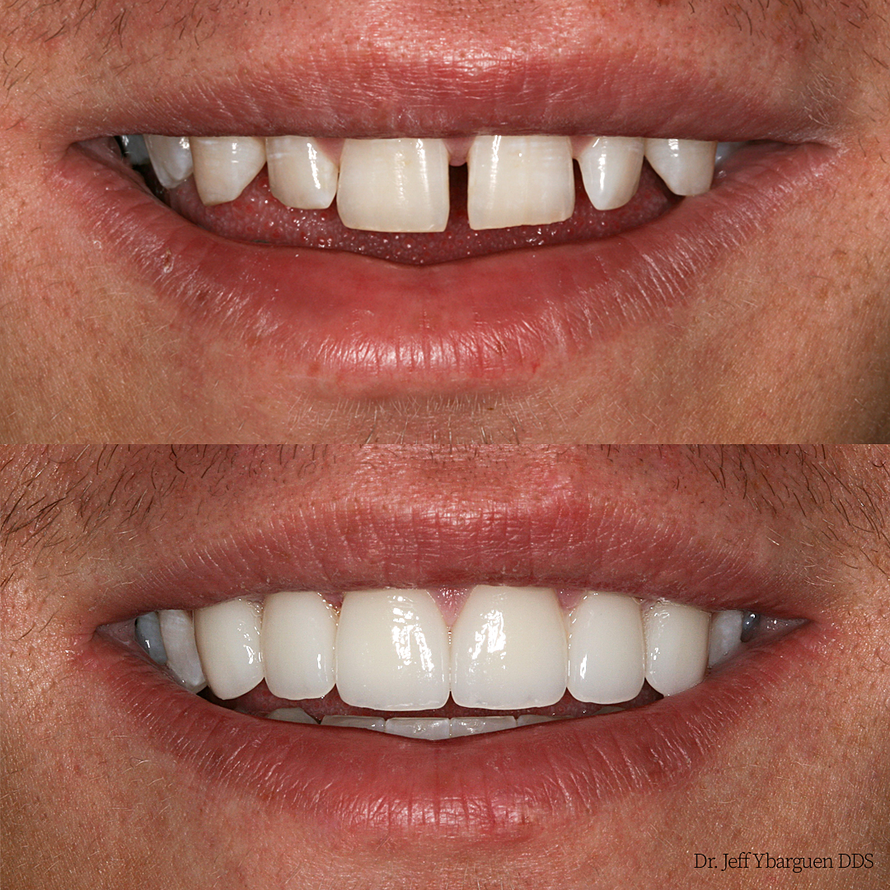

Slide 3
Dentistry
Mostly Pros
  Flexibility
    Various Practice Settings
    Hours
    Specialize, General Practice and focus a practice in areas
  Respected Member of the Community
  Choice of Practice Location
  Work with variety of people
  Clean work environment
  Decent income potential

Slide 4
Dentistry
Potential Cons
  Physically and mentally stressful
    Small detailed work
    People have anxiety about visiting the dentist
  No room for error either mentally or physically
  Speculation of healthcare reform
  Cost of education and getting established
  If own your own business know about:
    Profitability
    Insurance Codes and procedures
    Overhead, etc.

Slide 5
Idaho Dental Education Program
Contract between the State of Idaho and Creighton University in Omaha, Nebraska
Idaho purchases seats for Idaho residents at Creighton University School of Dentistry
First year at Idaho State University in Pocatello
Three years in Omaha at Creighton
Accepted students receive scholarship

Slide 6

Idaho State University
Division of Health Sciences
  Department of Dental Sciences
  Idaho Dental Education Program

Slide 7
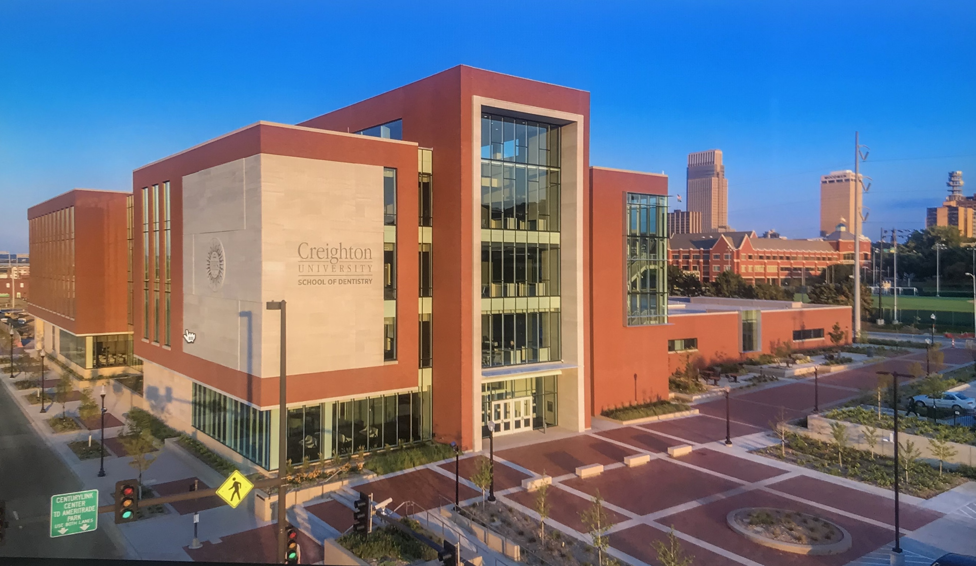
Creighton University School of Dentistry

Slide 8

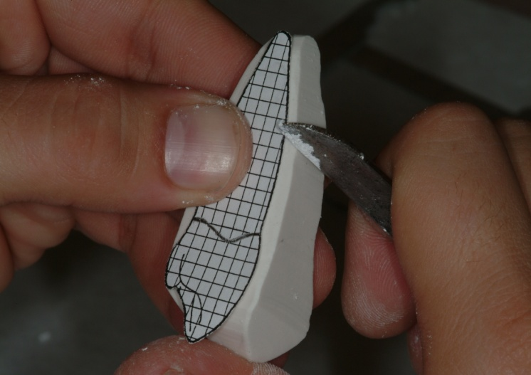
Idaho Dental Education Program
Academic Requirements
  High School Diploma or GED
  Pre-requisite courses
    Biology
    Chemistry
    Organic Chemistry
    Biochemistry
    English
    Physics
  Have bachelors degree upon entering the program

Slide 9
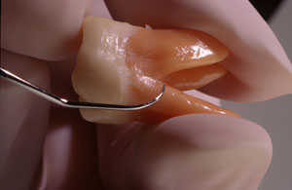
Idaho Dental Education Program
Non-Academic Requirements
  Good hand eye coordination
  Excellent people skills
  Some business acumen is helpful

Slide 10
Idaho Dental Education Program
Preparing to apply:
  Pre-dental advisor at your college – see them early and often
  Good to Excellent grades are important
  DAT scores are important – some schools place more emphasis than others – take it when it is best for you
  Put effort into essay. Have someone check grammar, spelling, clarity, etc.
  References from people who know you well

Slide 11
Idaho Dental Education Program
Preparation Continued:
  Become very familiar with the profession – shadow to become more familiar
  Pay attention to deadlines
  Call to check, but not “bug” the admissions office
  Prepare for interviews

Slide 12

Additional Resources for
Preparation / Application
American Dental Education Association (ADEA) Website:
https://www.adea.org/
The ADEA Official Guide to Dental Schools
  can be purchased through the above web-site
  May be accessed through your college library

Slide 13
Idaho Dental Education Program
Application process
  Complete your AADSAS Application indicating:
    Idaho as your state of Residency
    Creighton as one of the schools you are applying for admission
  Have a copy of your Dental Aptitude Test (DAT) scores sent to Creighton
  Complete the Creighton Supplemental Application with the appropriate fee

Slide 14
Idaho Dental Education Program
Application process cont.
  Have official transcripts from college course work submitted to Creighton as needed
  Have your personal references or pre-dental committee evaluation sent to Creighton
  Complete the Idaho Residency Certification form and return it to the IDEP office
  Creighton will forward a copy of your application to the IDEP office for consideration by our admissions committee

Slide 15
Idaho Dental Education Program
Application process cont.
  IDEP Admissions Committee:
    Evaluates academic and non-academic factors
    Gives preference to those applicants with highly qualified admissions profiles
    Invites top percentage of applicants to ISU in Pocatello for an interview
    Selects students to be accepted into the program based upon the above factors
    # of applicants:
      2018: 41 2019: 36 2024: 39
      2020: 33 2021: 28 2025: 45
      2022: 34 2023: 27 2026: 56

Slide 16
Idaho Dental Education Program
Admissions Statistics For 2023 Entering Class
  Applied Accepted
  Average GPA: 3.76 3.94
  Average DAT Academic: 21 23
  Average DAT Science: 20 22
  Average DAT PAT: 21 23

Slide 17
Idaho Dental Education Program
Admissions Statistics For 2024 Entering Class
  Applied Accepted
  Average GPA: 3.73 3.92
  Average DAT Academic: 21.4 22.5
  Average DAT Science: 20.9 22.8
  Average DAT PAT: 20.6 21.4

Slide 18
Idaho Dental Education Program
Admissions Statistics For 2025 Entering Class
  Applied Accepted
  Average GPA: 3.62 3.91
  Average DAT Academic: 20.4 22.4
  Average DAT Science: 20.3 22.6
  Average DAT PAT: 20.6 20.7

Slide 19
Idaho Dental Education Program
Admissions Statistics For 2026 Entering Class
  Applied Accepted
  Average GPA: 3.68 3.78
  Average DAT Academic: 437 447
  Average DAT Science: 438 450
  Average DAT PAT: 454 494

Slide 20
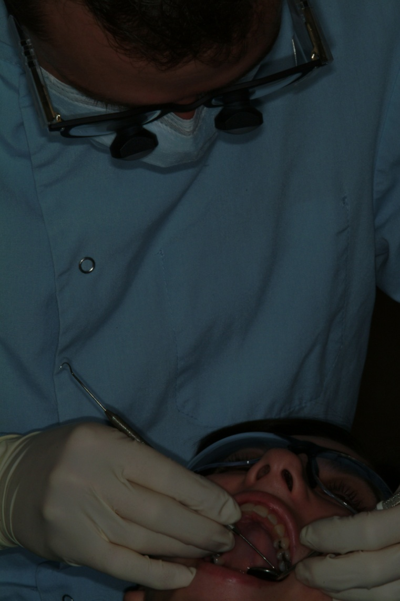
Idaho Dental Education Program
Consider the Advantages
  Small Class Size
  Favorable student to faculty ratio
  Cost advantage for Idaho Residents
  Excellent track record

Slide 21
Idaho Dental Education Program
Small class size
  Currently 9 students in each class
  9:1 student to faculty ratio in dental classes
  One-On-One individualized attention with faculty
  Allows students to get a solid start to their dental education
  Class size of 115 students at Creighton for years 2-4

Slide 22
Idaho Dental Education Program
Cost advantages for IDEP students (2023-24)
  1st year = $33,760
    Books, Instruments and Living Costs are additional
  2nd – 4th Years = $33,760 + Tuition Increases (3-6% Average)
    Books, Instruments, and Living Costs are additional
  Non-IDEP Creighton Tuition = $73,222
  54% savings by being an IDEP student over 4 years

Slide 23
Idaho Dental Education Program
Cost advantages for IDEP students (2024-25)
  1st year = $34,604
    Books, Instruments and Living Costs are additional
  2nd – 4th Years = $34,604 + Tuition Increases (3-6% Average)
    Books, Instruments, and Living Costs are additional
  Non-IDEP Creighton Tuition = $75,052
  54% savings by being an IDEP student over 4 years

Slide 24
Idaho Dental Education Program
Cost advantages for IDEP students (2025-26)
  1st year = $35,470
    Books, Instruments and Living Costs are additional
  2nd – 4th Years = $35,470 + Tuition Increases (3-6% Average)
    Books, Instruments, and Living Costs are additional
  Non-IDEP Creighton Tuition = $76,932
  54% savings by being an IDEP student over 4 years

Slide 25
Idaho Dental Education Program
Cost advantages for IDEP students (2026-27)
  1st year = $36,366
  Books, Instruments and Living Costs are additional
  2nd – 4th Years = $36,366 + Tuition Increases (3-6% Average)
    Books, Instruments, and Living Costs are additional
  Non-IDEP Creighton Tuition = $78,858
  54% savings by being an IDEP student over 4 years

Slide 26
DEBT UPON GRADUATION
Sources: ADEA Survey of Dental Graduates and Creighton University Financial Aid Office
YEAR | NATIONAL AVG | CREIGHTON AVG | IDEP AVG
2009 | $230,478 | $201,425 | $153,707
2012 | $263,382 | $208,744 | $186,413
2021 | $354,901 | $266,404 | $221,563
2023 | $423,750 | $339,349 | $245,085
2024 | $432,865 | $345,181 | $225,355
2025 | $471,629 | $391,452 | $247,250
2026
  2026 Nationally:
  (Source: ADEA Snapshot of Dental Education 2018-19)
Notes:
In 2014 2 students had little or no debt. In 2017, all 8 IDEP graduates had debt.. Low = $206,682 to High = $234,582. In 2018 all 8 IDEP students had debt… Low = $79,444 to High = $299,266.

Slide 27
Proven Track Record:

Slide 28
WREB: Creighton vs National Pass Rate
WREB = Western Regional Examining Board
(Patient Based Clinical Board Examination)
Graduating Class | Creighton First Time Pass Rate | National First Time Pass Rate
14 | 94.6% | 81.6%
18 | 93.5% | 86.3%
23
24
25
26
Average

Slide 29
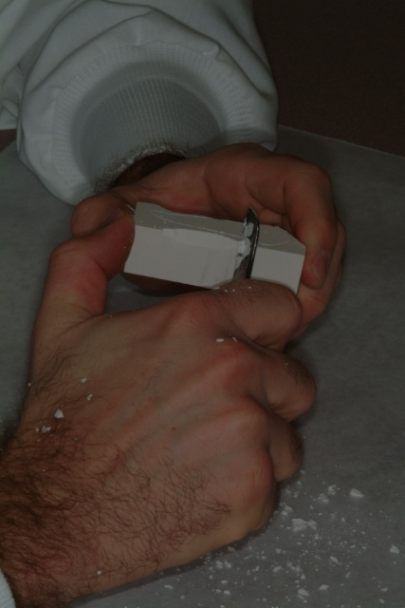
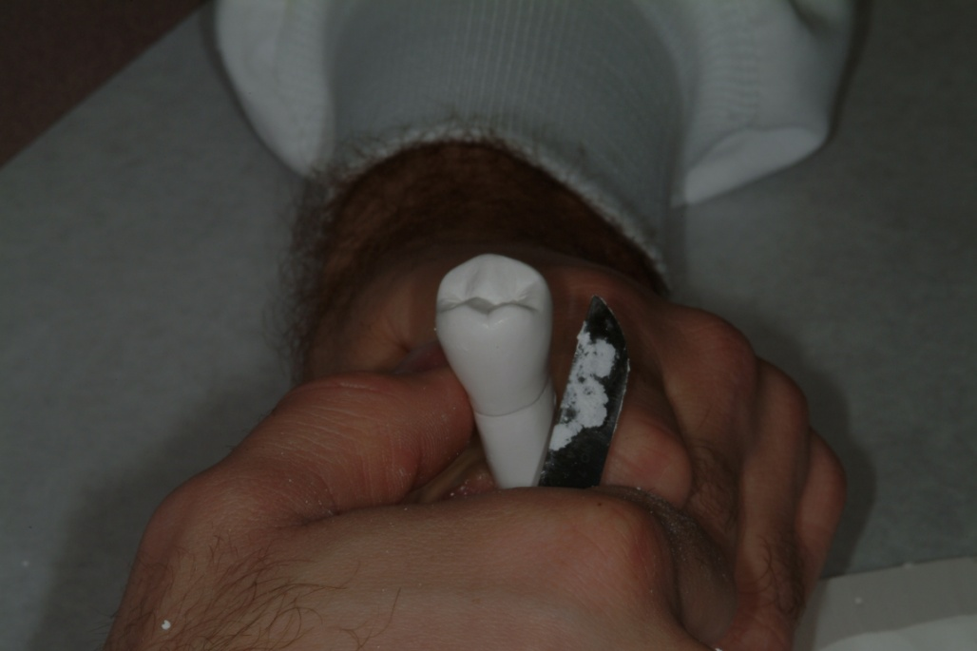
Idaho Dental Education Program
First Year
  A time to develop skills
  A time to develop relationships

Slide 30
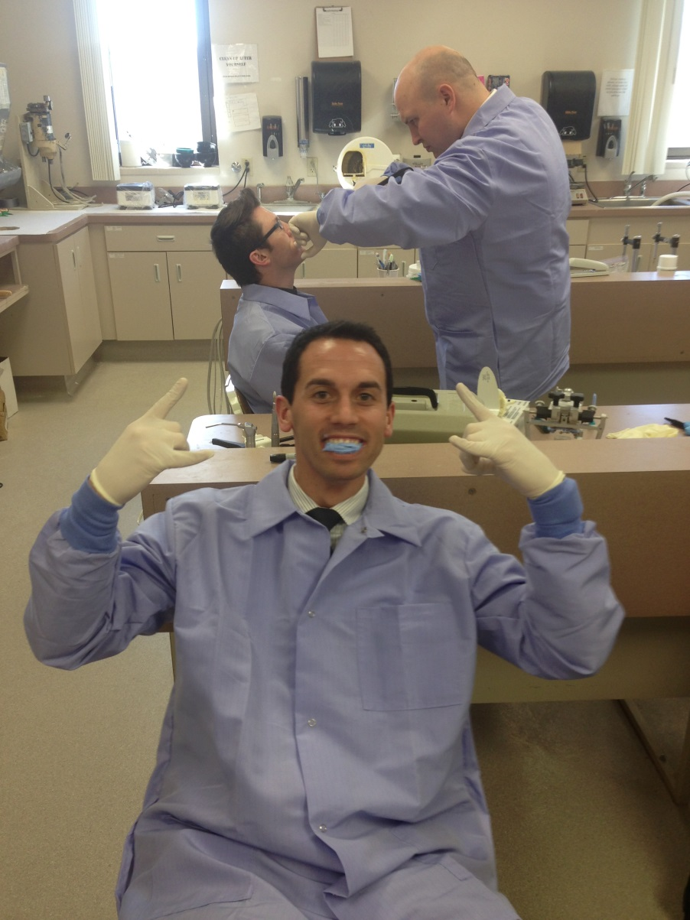
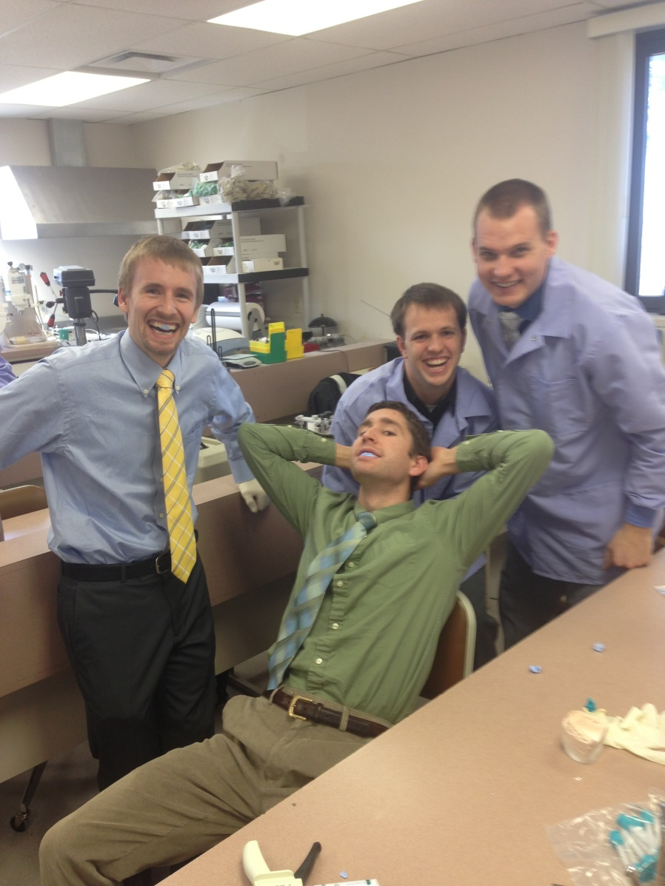
Idaho Dental Education Program
Notes:
Forest Hulet, Jason Streeper, Devon Rasmussen Houston Tanner, Josh Rice, Joseph Erickson, and Logan Hill

Slide 31
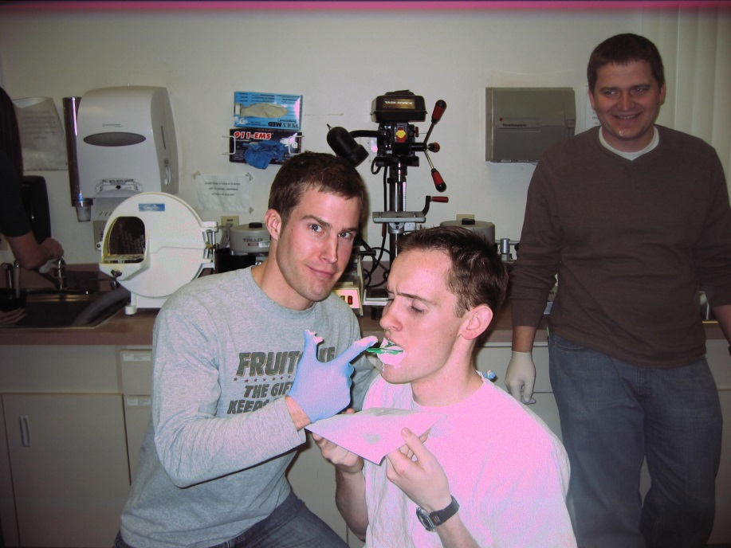
Idaho Dental Education Program
Notes:
Ben Hilton, Jordan Hillam, Devin Thompson

Slide 32
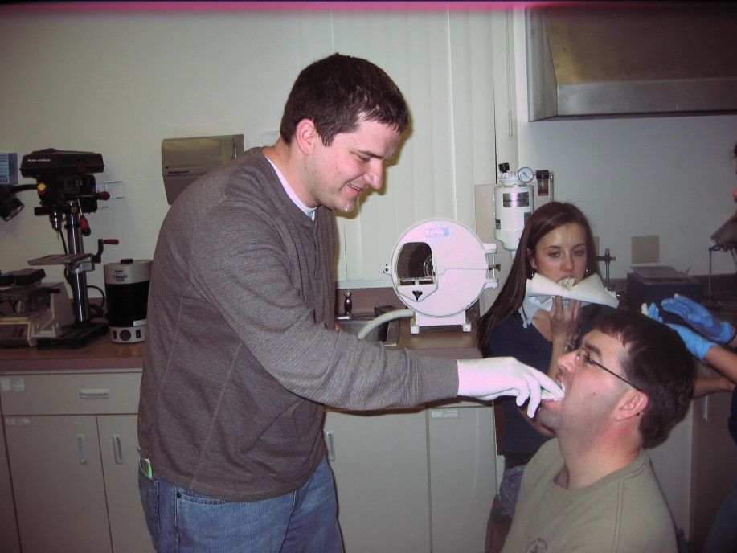
Idaho Dental Education Program
Notes:
Devin Thompson, Robert Chaffin, and Janica Gilette

Slide 33
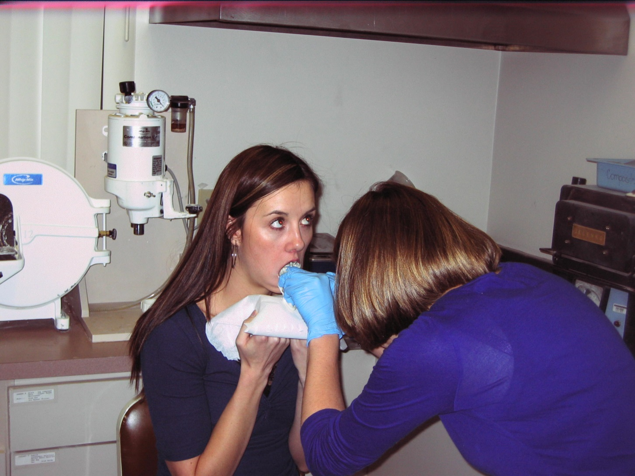
Idaho Dental Education Program
Notes:
Janica Gilette and Britney Penberthy

Slide 34
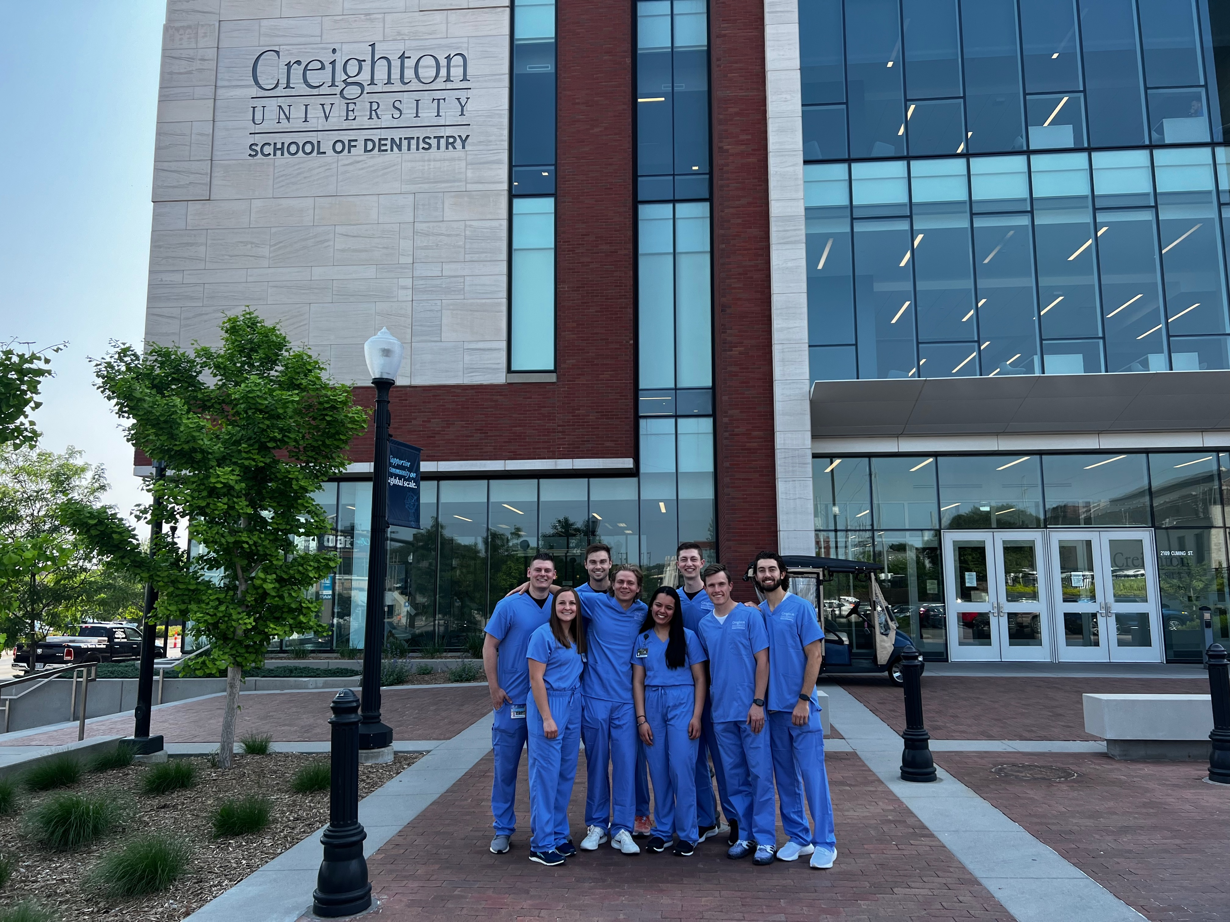

Slide 35
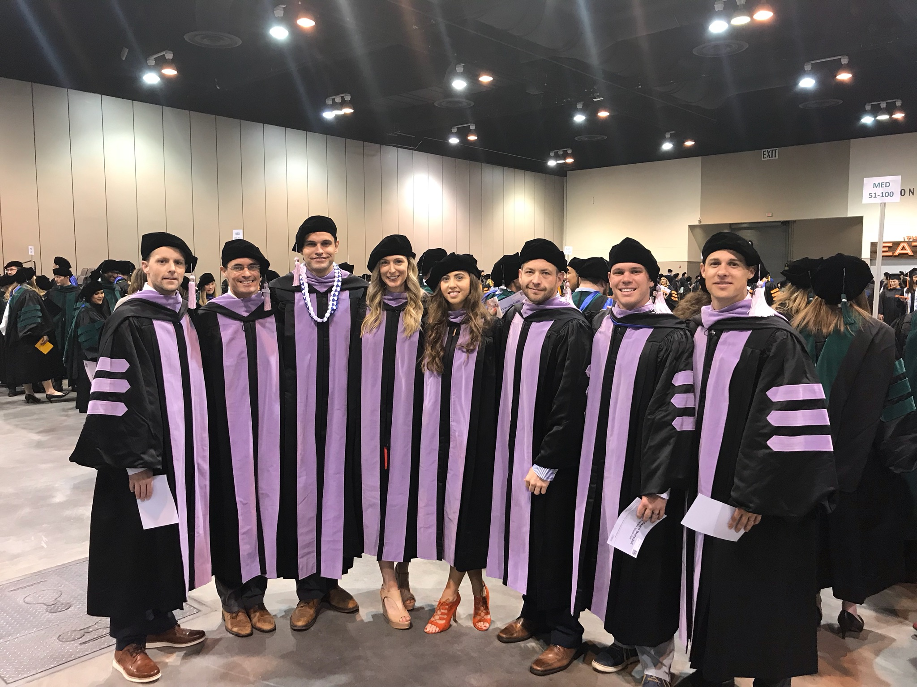
IDEP STUDENTS - CREIGHTON GRADUATING CLASS OF 2018
L-R: Dallin Larson, Austen Weeks, Stuart Allyn, Tayler Asplund, Najla Pajezetovic, Stuart Tucker, Paul Blaisdell, and Brent Cline
Notes:
Dallin Larson (ENDO – Boise), Austin Weeks (dental anesthesia), Stuart Allyn (OMFS), Taylor Asplund Fuller, Naijla Pajazetovic, Stuart Tucker, Paul Blaisdell, Brent Cline

Slide 36
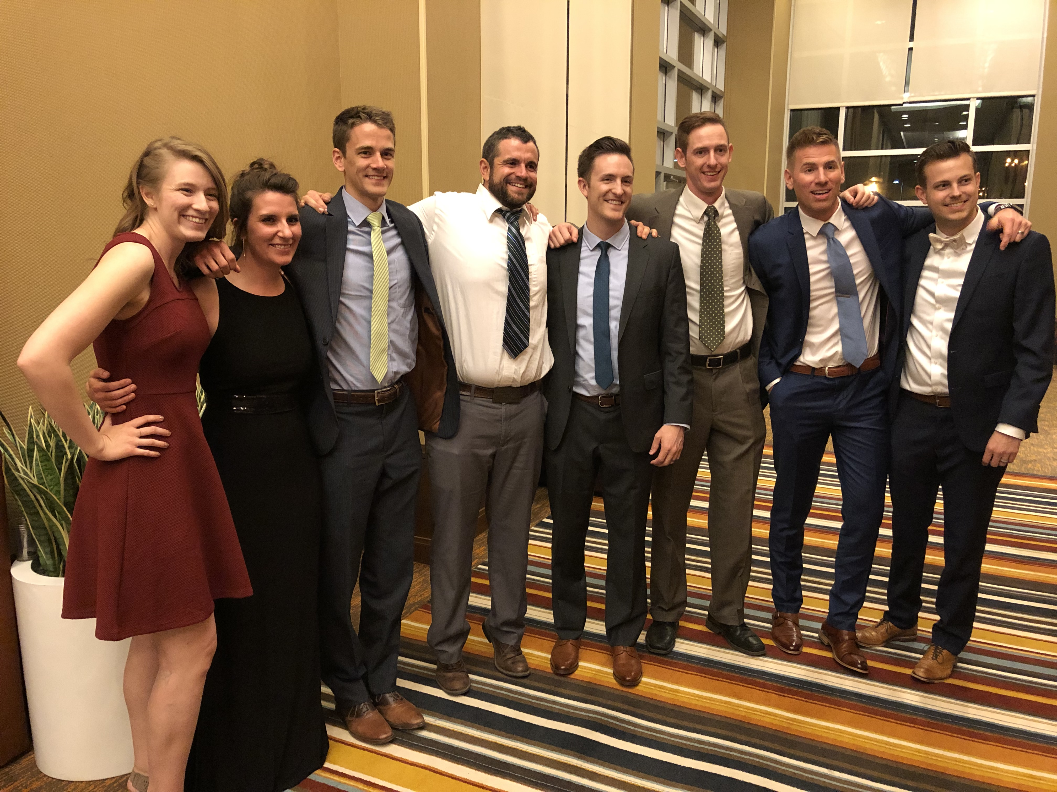
IDEP STUDENTS - CREIGHTON GRADUATING CLASS OF 2019
L-R: Jenna Kedish, Bry Martin, Marc Soelberg, Brandon Call, Scott McLaren, Eric Hillam, Daniel Whitesitt, Jordan Clawson
Notes:
Jenna Kedish: IAGD Boise Bry Martin: IAGD Spokane Marc Soelberg: PEDO Residency San Diego Brandon Call: Private Practice Pocatello Scott McLaren: PEDO Residency OHSU Eric Hillam: Ortho Residency St. Luis Daniel Whitesitt: Private Practice Rathdrum ID Jordan Clawson: DD – OMFS Residency Vanderbilt

Slide 37
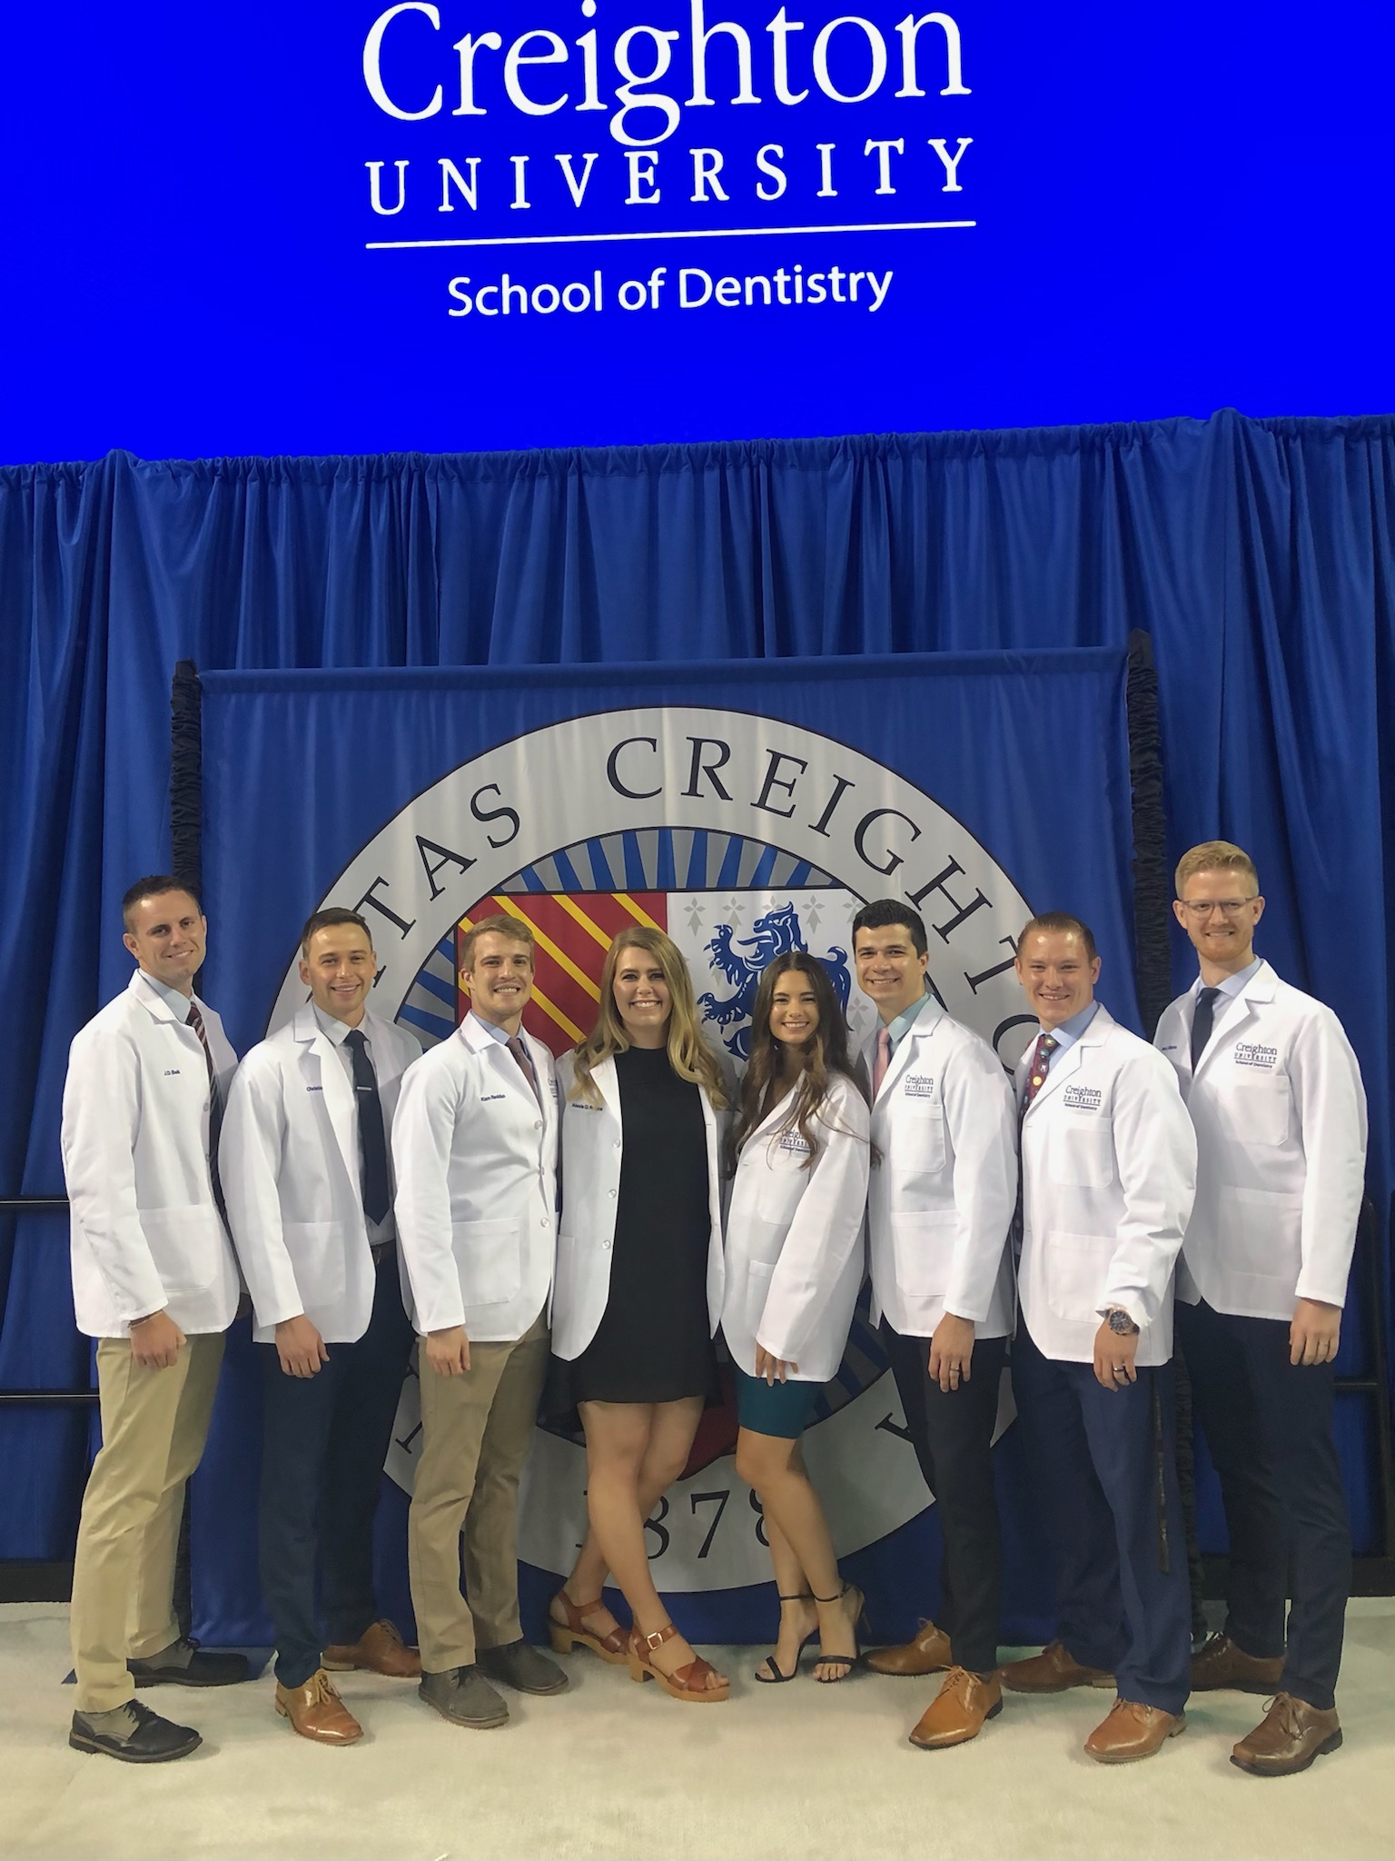
IDEP STUDENTS - CREIGHTON GRADUATING CLASS OF 2023
L-R: Justin Belk, Christian Fowler, Kam Reddish, Alexis Rawlings, Miranda Anderson, Tim Balzen, Jeremy Nelson, Jalen Gibbons

Slide 38
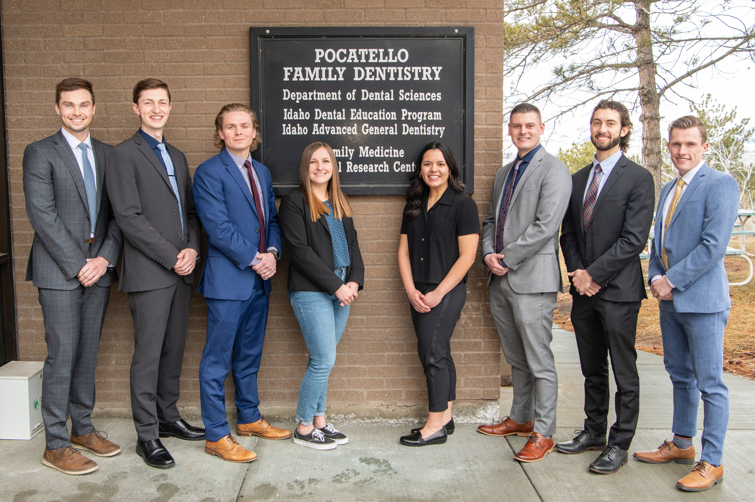
D1 IDEP STUDENTS SPRING 2023
L-R: Taylor Thomason, Jake Hansen, Noah Parks, Emily Tesnohlidek, Joselynn Castillo, Tyler Hurst, Tylor Clark, Brandon Harding

Slide 39
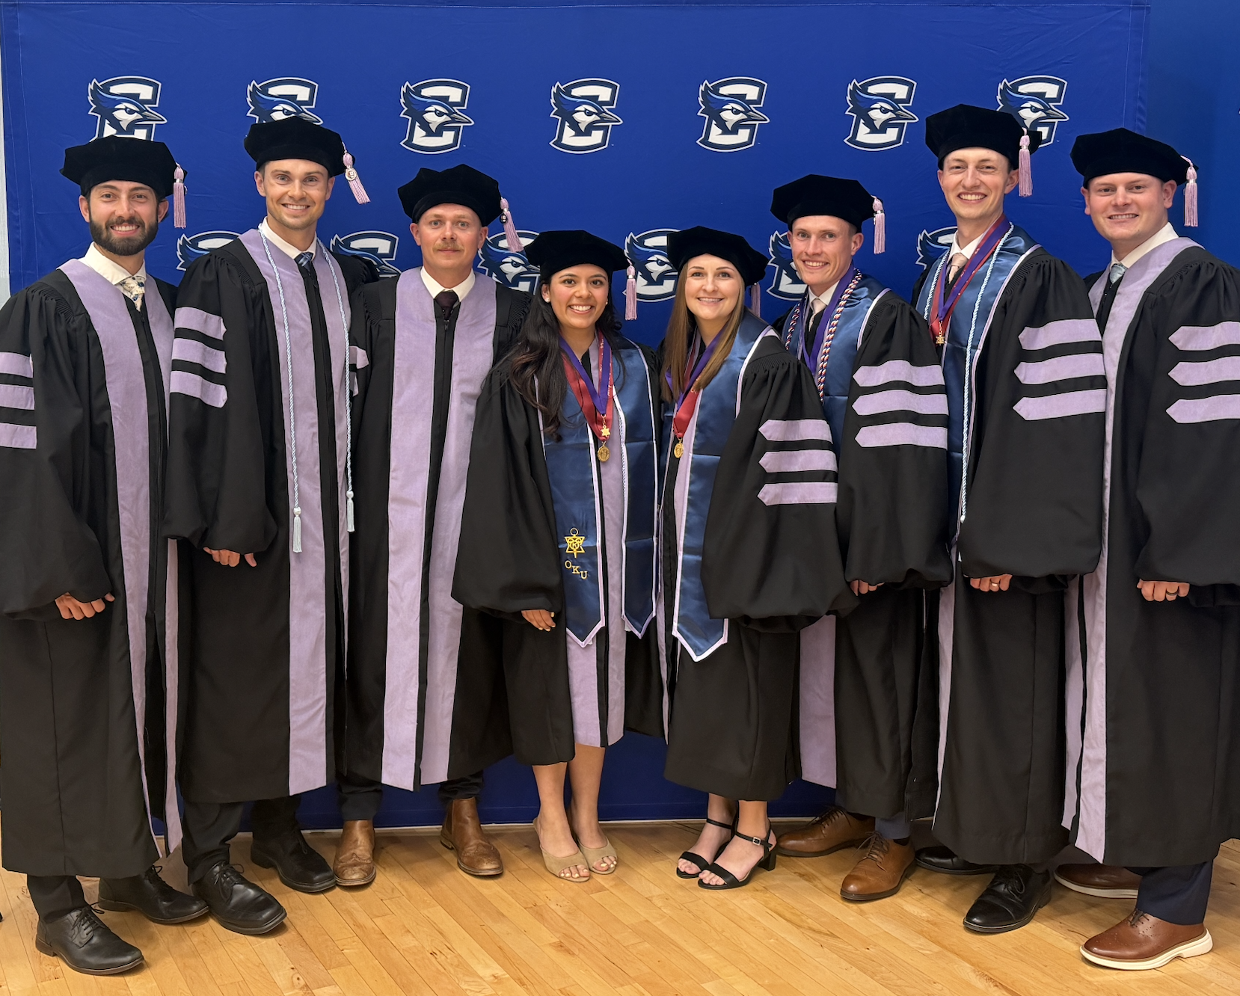
IDEP STUDENTS – CREIGHTON GRADUATING CLASS OF 2026
L-R: Tylor Clark, Taylor Thomason, Noah Parks, Joselynn Castillo, Emily Tesnohlidek, Brandon Harding, Jake Hansen, Tyler Hurst

Slide 40
IDEP 1st Year Curriculum
Fall
  Gross Anatomy
  Histology
  Dental Biochemistry
  Physiology
  Head & Neck Anatomy
  Dental Materials
  Preventive Dentistry
  Dental Anatomy
  Oral Histology & Embryology
Spring
  Neuroscience
  Nutrition
  Community Dentistry
  Oral Hygiene Techniques
  Occlusion/Fixed Prosthodontics
  History of Dentistry
  Values and Ethics
  Interpersonal Relations and Communications
  Research

Slide 41
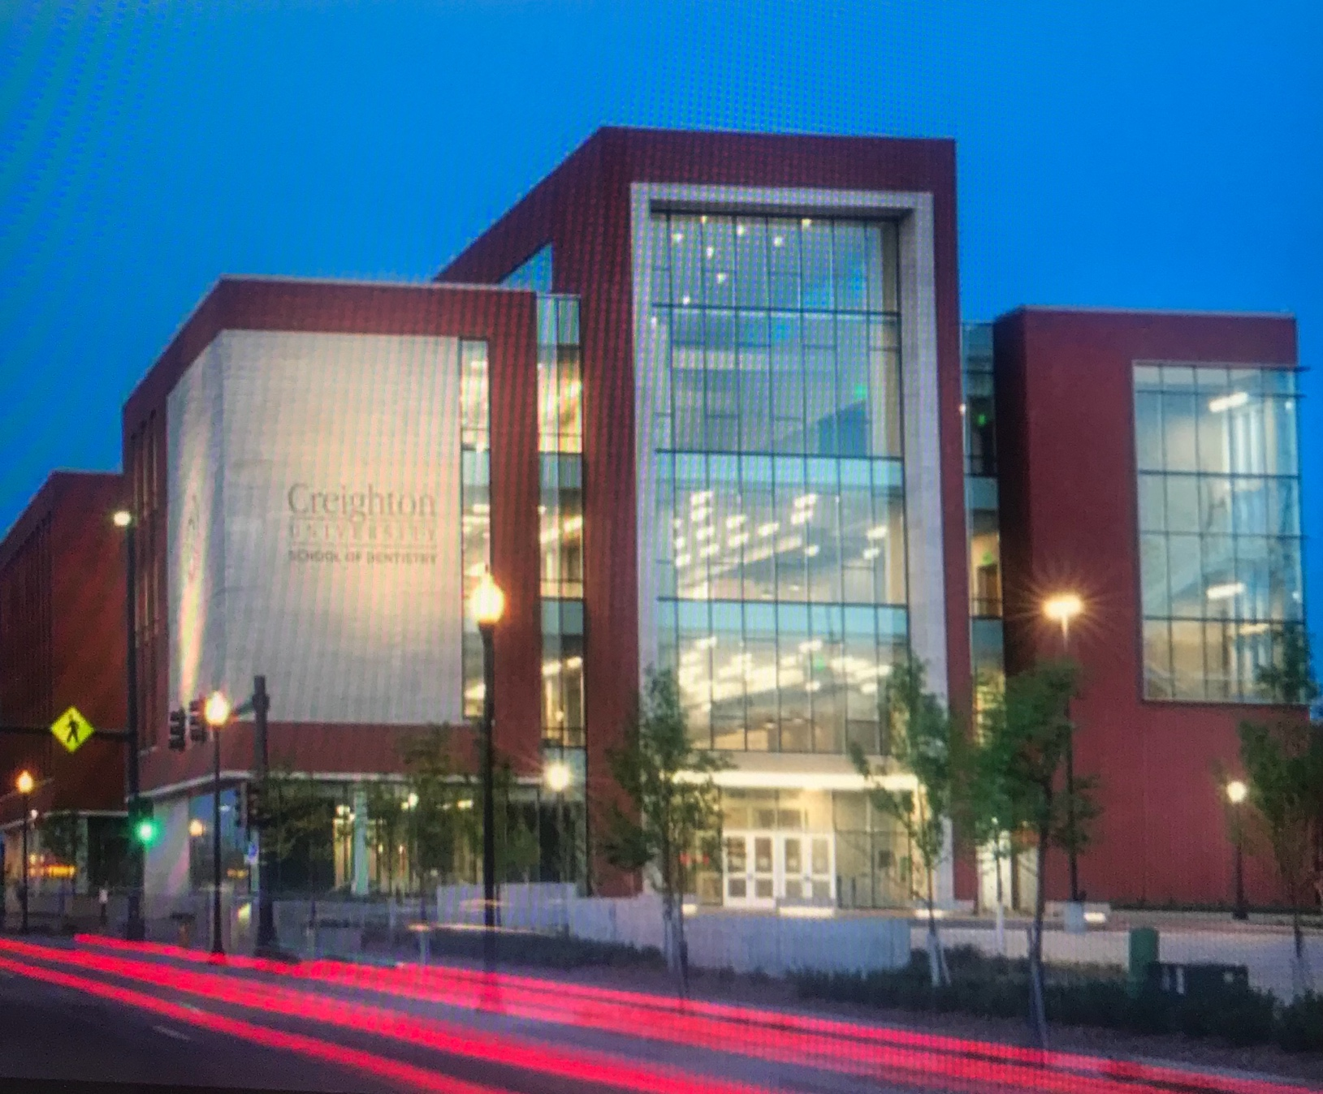
Creighton University School of Dentistry
Dental School
Urban environment
  Extensive Activities
  Outstanding Patient Pool
  Excellent Academic Track Record
  Premier Clinical Program

Slide 42


Creighton University School of Dentistry
State of the Art Clinical Sterilization Facility
Modern Teaching Laboratories
Excellent facilities in general

Slide 43
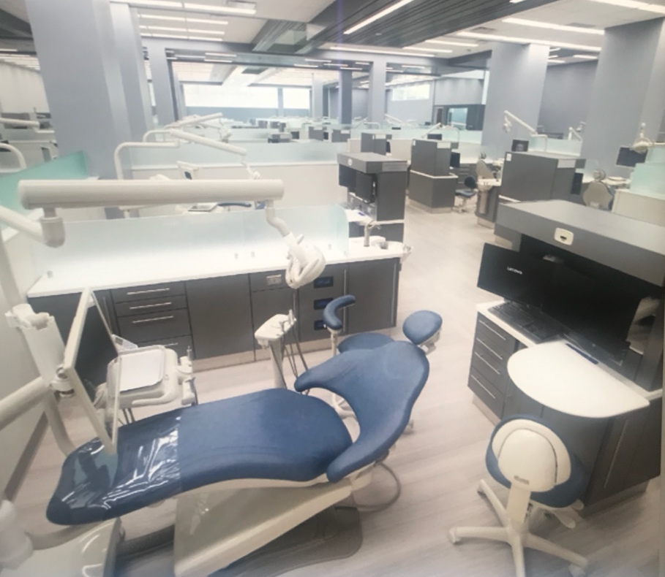
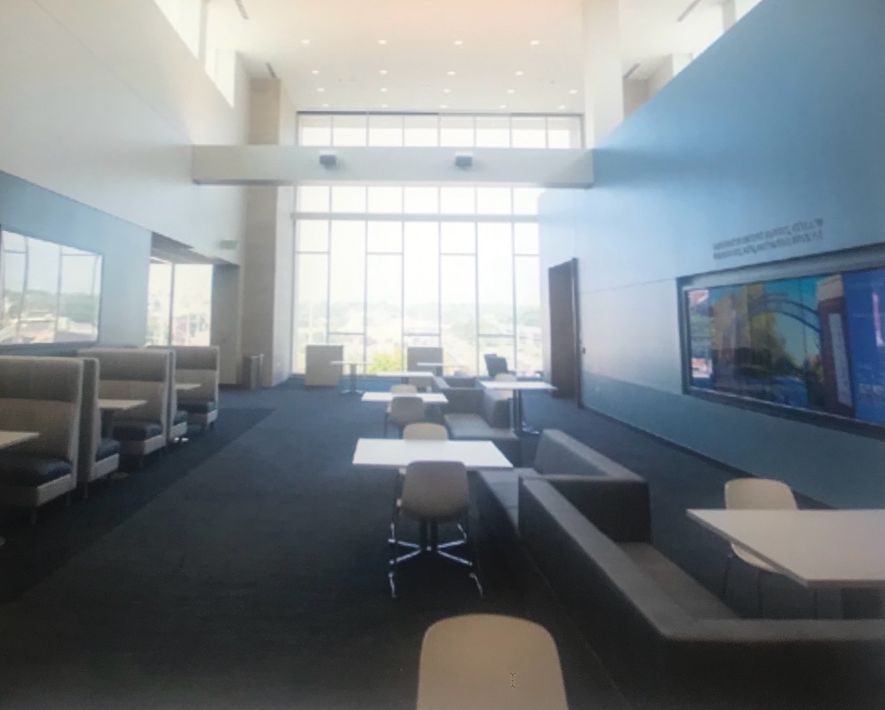
Creighton University School of Dentistry
Excellent Patient Base for Teaching Cases
No specialty programs or advanced education programs – all patients for the dental students
  Provides dental students experience with specialty areas of dentistry
  Taught by specialists in these areas

Slide 44
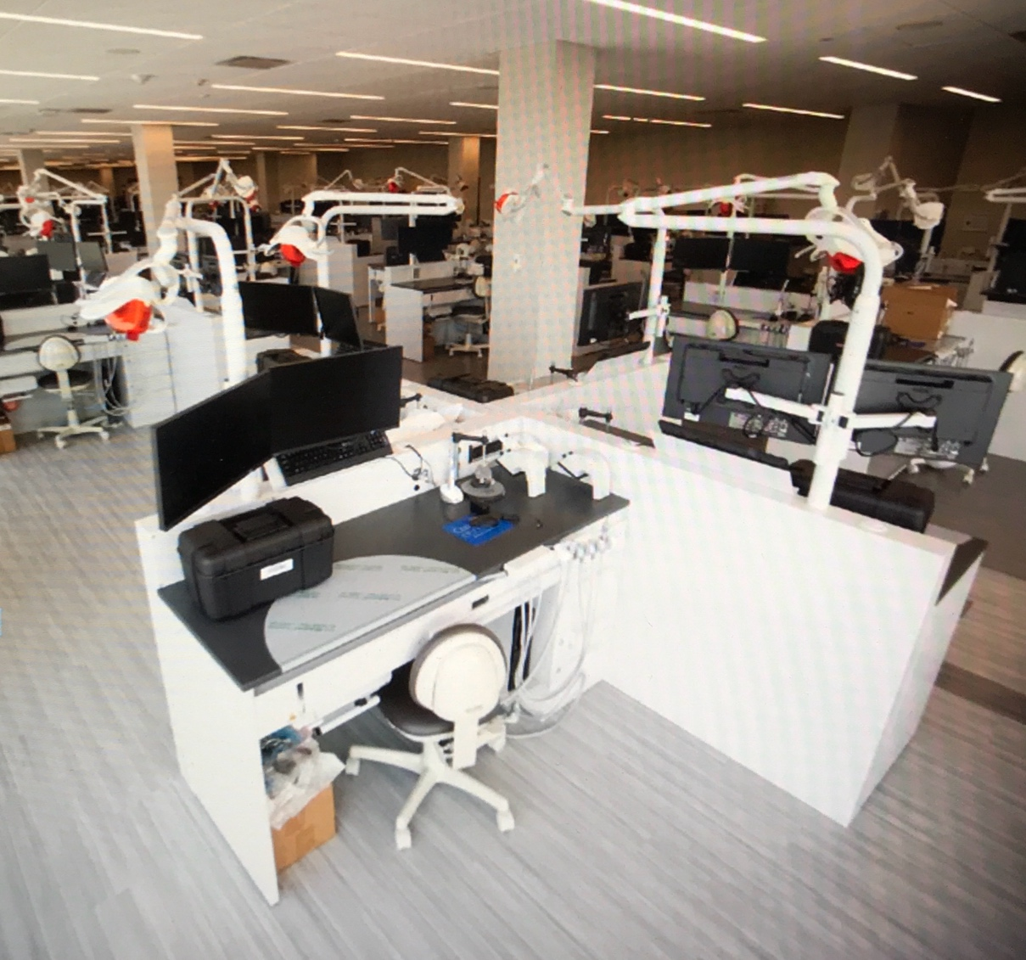
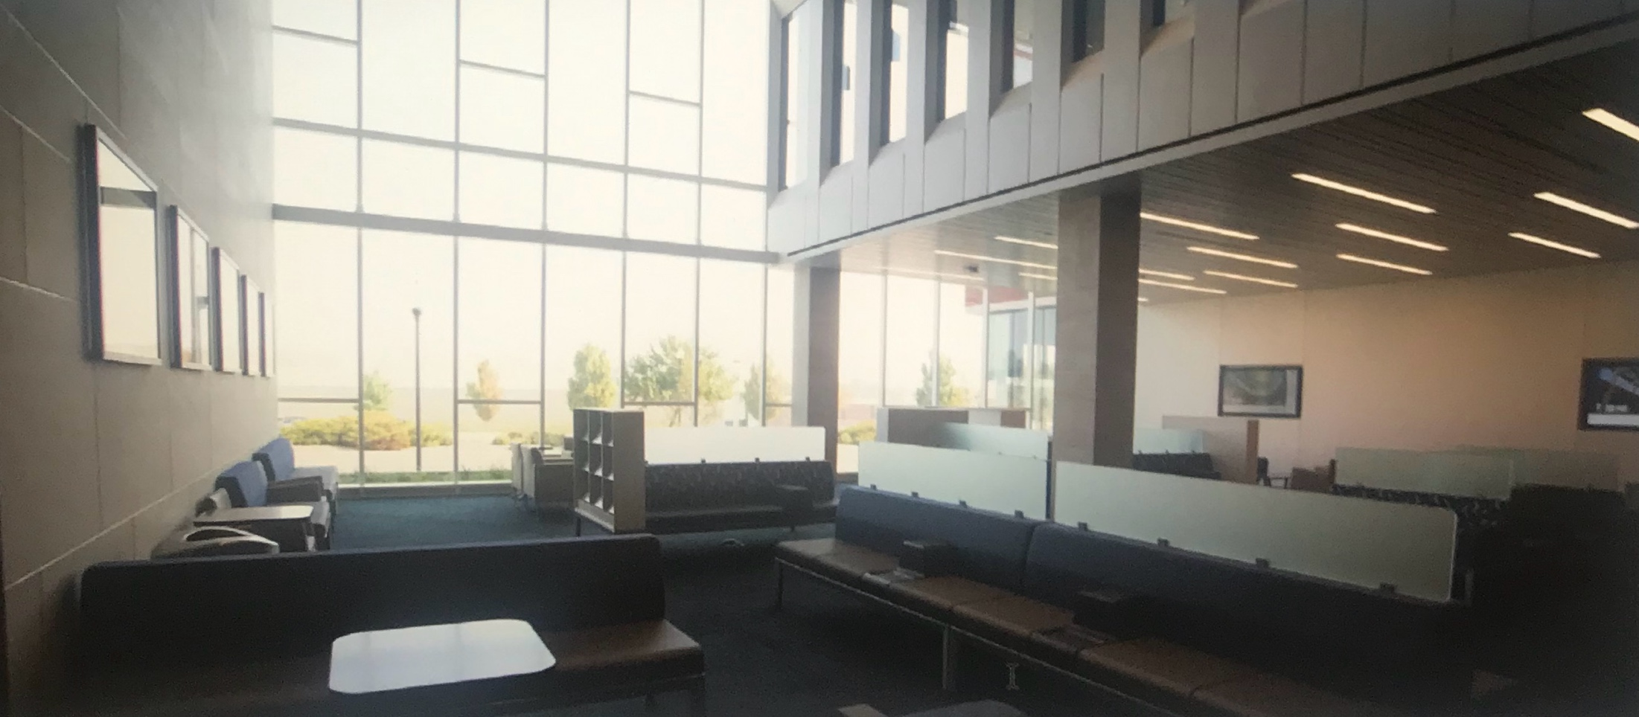
Creighton University School of Dentistry
Cone Beam CT Scanning
Simulation Lab
CEREC
Computer Monitors at Each Work Station

Slide 45
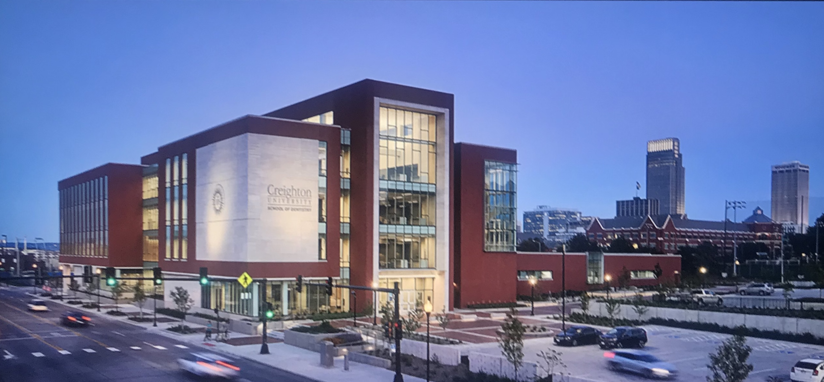
Creighton University
School of Dentistry

Slide 46
What Our Graduates Say:
“The IDEP program provided me with an opportunity to attend one of the best dental schools in the nation. Creighton produces great general dentists and the clinical experience is unmatched. I felt ready and confident the day I graduated, which is why I chose to buy a solo general practice. I have been successful thus far, and I can thank Creighton and the IDEP program.”
- Jayson Bird, DDS

Slide 47
What Our Graduates Say:
“I am definitely pleased that I chose to attend Creighton University via the Idaho Dental Education Program. The day I started at my practice, the senior dentist who I was supposed to be working with had to go in for cardiac bypass surgery and retired. I felt very prepared to walk in and confidently do dentistry. It has been three months now and the business side is slowly coming around, but the transition wouldn’t have gone smoothly if the dentistry part wasn’t there.
- Carla Grossklaus Kucirek, DDS

Slide 48
What Our Graduates Say:
“I could go on and on about how the IDEP experience blessed my life. I received a significant scholarship and got to spend the first year in Idaho. The small class size of 8 with brilliant students who each sacrifice to help each other succeed. There is an expansive patient base that allows students to stay busy performing many different procedures. The best thing I received was the opportunity to sit on the shoulders of giants in the dental industry and let them help craft me into not only a better dentist, but a better person also.”
- Matt Kunz, DDS

Slide 49
Why I Chose IDEP:
“I chose IDEP for a number of reasons. It was really great to be a part of a class of only 8 students for the first year of dental school. This is a time where you build a foundation for what you’ll be doing for the rest of your career. In IDEP you have a great opportunity to get immediate feedback and close interaction with the instructors, due to the small class size, to develop the fundamental concepts and skills. The majority of the dental related instructors operate a private practice and can share a wealth of knowledge about what dentistry will be like after school. The instructors not only teach you a great deal about the technical aspects of dentistry, but also about how to become a great member of the dental community that practices with honor and integrity. Lastly, the financial aid that IDEP provided will allow me to be in a better position financially when I enter the work-field. IDEP is a great opportunity and one that will build the foundation for a successful dental career.”
-Ryan Morris (CU Class of 2015)

Slide 50
Idaho Residency
In order to be considered for the IDEP, applicants must prove Idaho Residency
Residency Determination Worksheet must be completed and approved
https://boardofed.idaho.gov/resources/residency-determination-worksheet/
The completed form can be sent to the IDEP office :
  Idaho Dental Education Program
  Idaho State University – Stop 8088
  Pocatello, ID 83209-8088

Slide 51


Slide 52
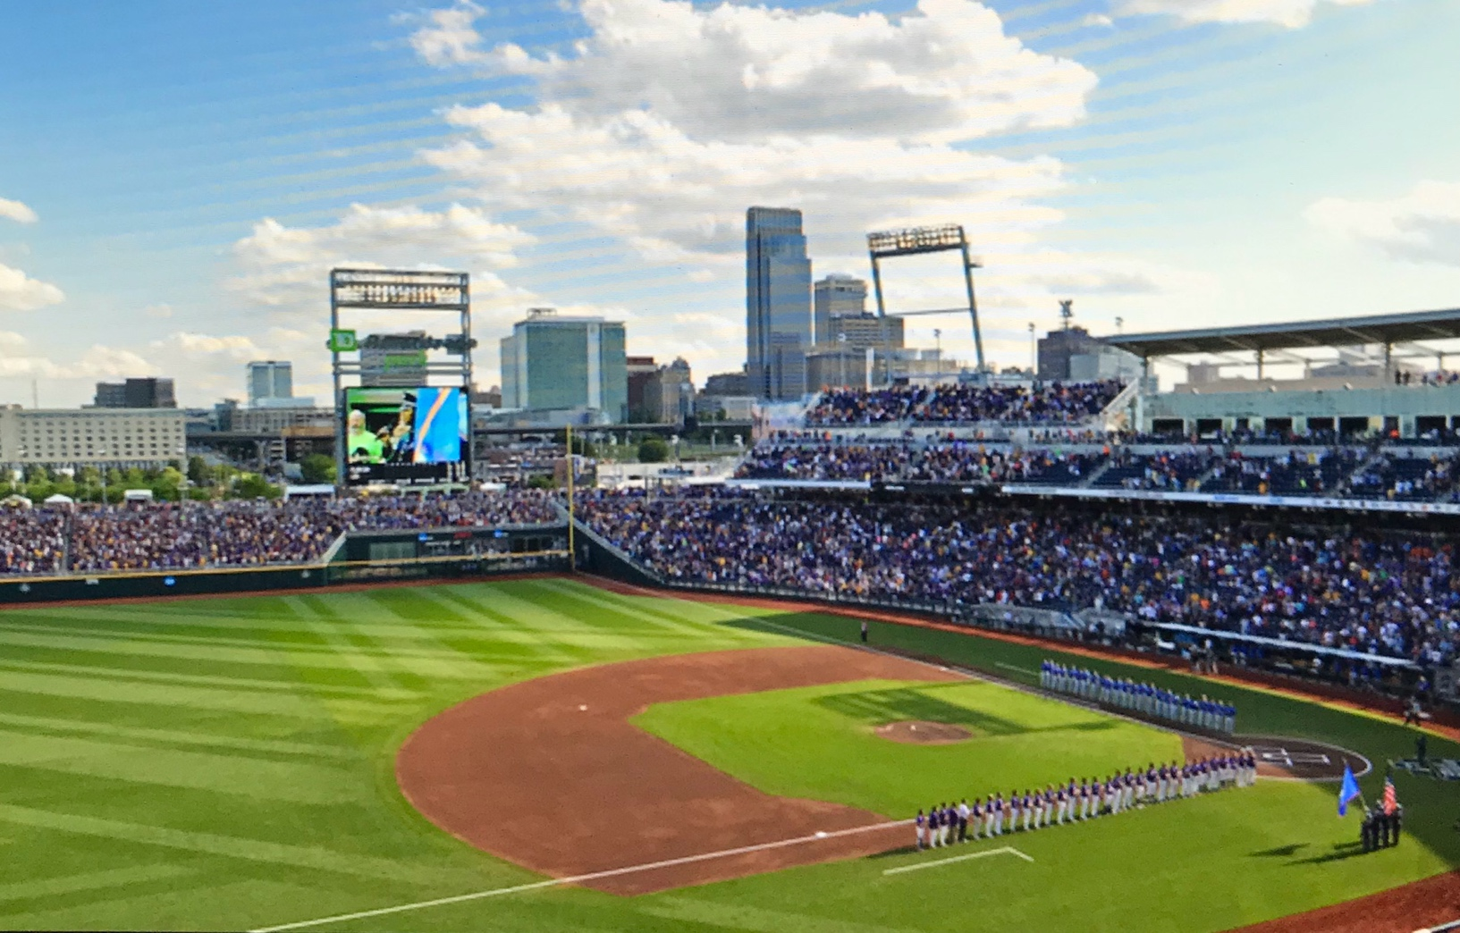

Omaha, Nebraska
Big City with a Small Town Feel

Slide 53
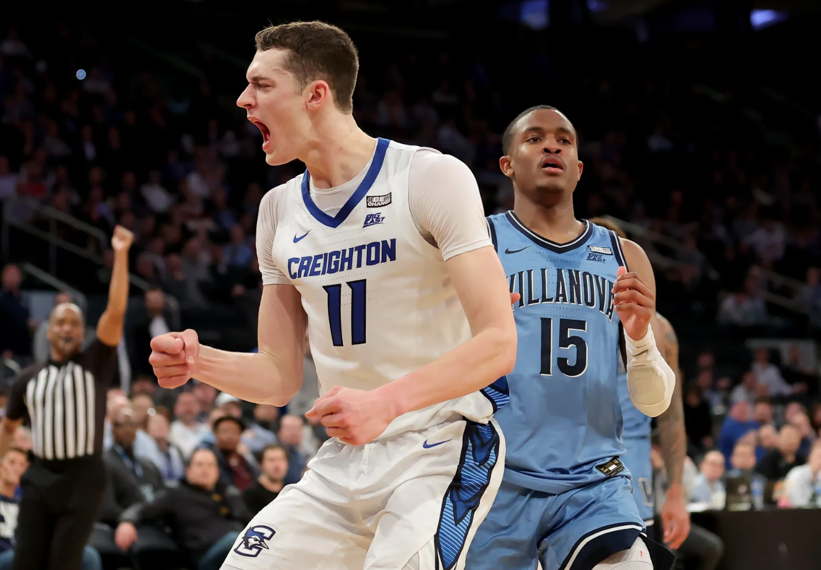

Slide 54


Slide 55

Omaha, Nebraska

Slide 56

Omaha, Nebraska

Slide 57
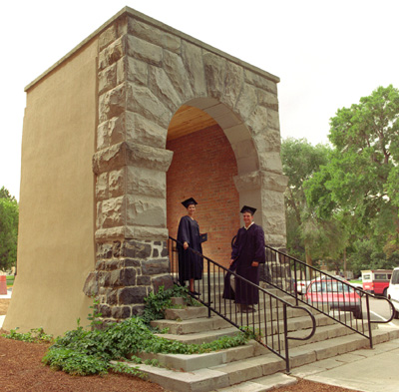
IDEP – Your Personal Gateway to Dentistry

Slide 58

Jeff Ybarguen, DDS
ybarj@isu.edu or (208)282-3289

