Slide 1
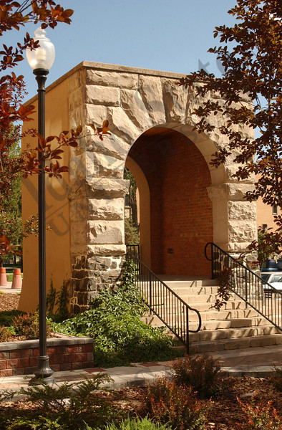
ISU Faculty Assembly:
An Open Exchange with the Provost
Dr. Laura Woodworth-Ney
10/10/2016

Slide 2
EVP/P Reporting Lines- Things Have Changed
Executive VP /Provost
Faculty Affairs
Faculty
Faculty Fellow
Faculty Affairs Coordinator
Faculty Senate
Management Assistants
(duel reporting to Vice Provost)
Director, HR
VP, Finance and Administration
(CFO (I))
VP, Student Affairs
VP, Research
VP, Health Sciences
AVP Facilities
Vice Provost Academic Strategy & Institutional Effectiveness
AVP, Enrollment Management
AVP for Academic Affairs (with temp TSO duties)
CIO, IT
AVP, Undergraduate Affairs (Temp)
Outreach Centers for Learning
Project Manager
Director, Institutional Research
AA Financial Analyst
Deans

Slide 3
What I’d like for us to accomplish today
Provide updates related to accreditation, strategic planning, and the renewed priority of the academic mission at ISU
Share with you the hope I have that together we can rebuild mutual trust and cooperation
Reinforce my commitment to the Faculty’s role in academic policies and other administrative planning processes
Two new initiatives
  Transparent budget model process to address budget issues
  Faculty team to creatively address recruitment and retention
Questions and answers
Notes:
This slide is new

Slide 4

Accreditation: Mission and Core Themes
Year-One Self-Evaluation
  Review and rewrite mission and core themes took place last fall 2015
  Approved by the State Board of Education in March 2016
  Accepted by the NWCCU in July 2016
Met the NWCCU’s expectations of Recommendation #1-
  Revise mission statement or review and revise its core themes

Slide 5
Accreditation: Recommendations
ISU satisfied the NWCCU expectations for Recommendations #2 & #5 in July 2016
  Recommendation #2-
    Build on governing framework by promoting an environment of transparency and collegiality resulting in trust
    This satisfies NWCCU for accreditation purposes
    Examples: IEAC and new strategic planning process
This does not satisfy me. It is my goal to continue working toward increased transparency

Slide 6

Accreditation: Recommendations
ISU satisfied the NWCCU expectations for Recommendations #2 & #5 in July 2016
  Recommendation #5-
    Develop and implement a process of
    ongoing assessment of student learning
    outcomes for its General Education
    program

Slide 7
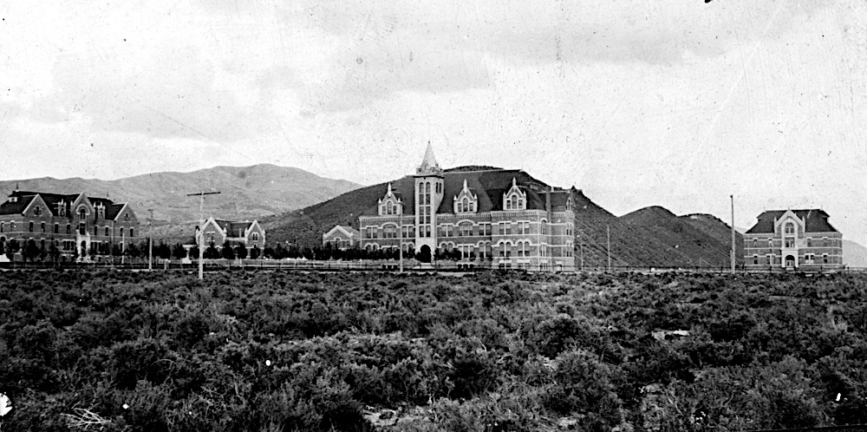
Role of the Institutional Effectiveness and Assessment Council (IEAC)
IEAC promotes the alignment of plans and proper resource allocation to appropriately advise upper administration
IEAC representation includes faculty, staff, and students to strive for greater transparency and inclusion

Slide 8
IEAC Steering Committee Membership
Laura Woodworth-Ney – Chair
Brian Hickenlooper –Finance Subcommittee Chair
Dr. Neels Van der Schyf – Core Theme 1 Subcommittee Chair
Dr. Pat Terrell – Core Theme 2 Subcommittee Chair
Dr. Rex Force – Core Theme 3 Subcommittee Chair
Dr. Kent Tingey – Core Theme 4 Subcommittee Chair
Randy Gaines – Technology Subcommittee Chair
Cheryl Hansen – Facilities Subcommittee Chair
Selena Grace
Dean Representative- TBD
Vince Miller – Supervisor of Institution-Level Metrics Collection
Jeff Tingey
Makayla Muir- ASISU
Paul Watkins- Faculty Senate Co-chair
Brian Sagendorf
Non-Voting Advisory Participants
Dr. Richard Brey
Lewis Eakins
Darren Blagburn

Slide 9

IEAC Outcomes
Better alignment of planning processes:
  Eliminating silos
  Aligning resource allocation
  Establishing a common goal
Council shifts strategic planning to a clear focus on our academic mission

Slide 10
My Commitments as EVP/Provost
Academic mission drives all planning on campus
  Long term: continue my effort to mend the relationship between the administration and the faculty
  A diverse and representative set of individuals create a new strategic plan
  Develop new processes that are transparent and aligned to the strategic plan
  Include faculty in key planning process like student recruiting and retention and assessment
  Transition all planning functions to become student centric

Slide 11

My Commitments as EVP/Provost
Implement new transparent budget model process to address budget issues
Utilize faculty expertise to solve campus problems, e.g. faculty teams to address recruitment and retention, assessment, etc.
Encourage and support the Faculty Senate’s role in enhancing faculty governance
Notes:
This is a new slide

Slide 12
Questions?

